Slide 1


Slide 2

The Island Games Postcard Competition was an opportunity to allow the young people across our Islands to show how they saw their homes through a postcard format. We saw over 120 entries received, and through this have chosen 9 postcards to be printed and will be used to send messages of well wishes.
We hope you enjoy viewing all the entries compiled together from each Island that took part. Thank you to each person who submitted an entry – you have given us a fantastic insight into your Island to share with our fellow Islanders.

Slide 3

GIBRALTAR
Gibraltar Middle School – year 5 and 6

Slide 4
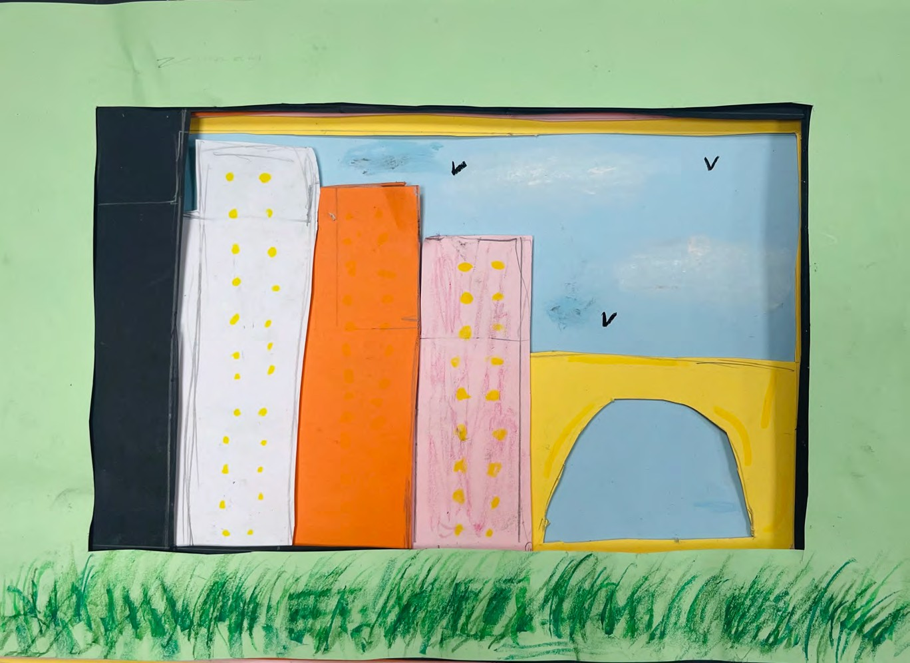

Slide 5
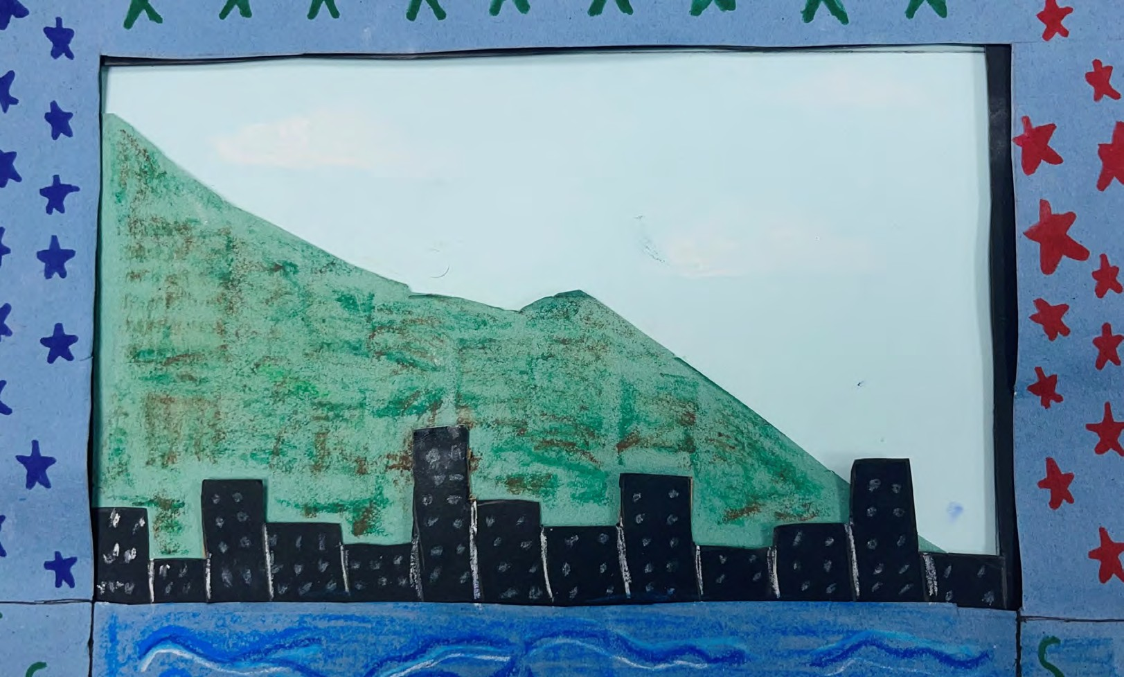

Slide 6
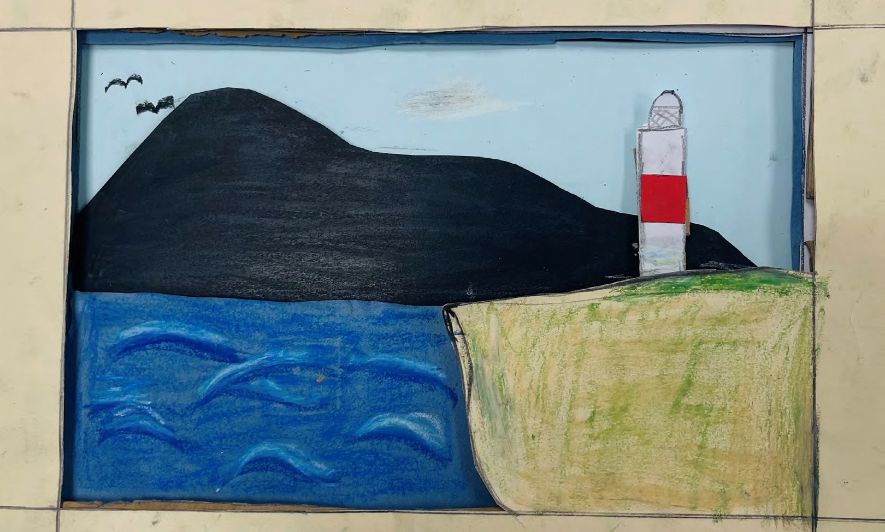

Slide 7
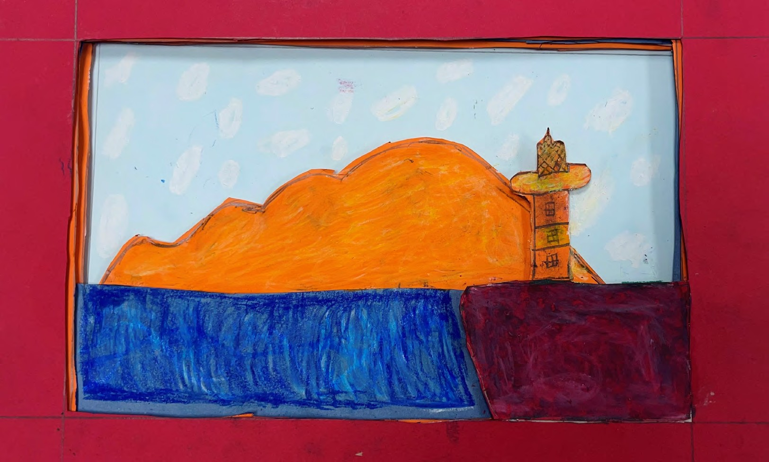

Slide 8
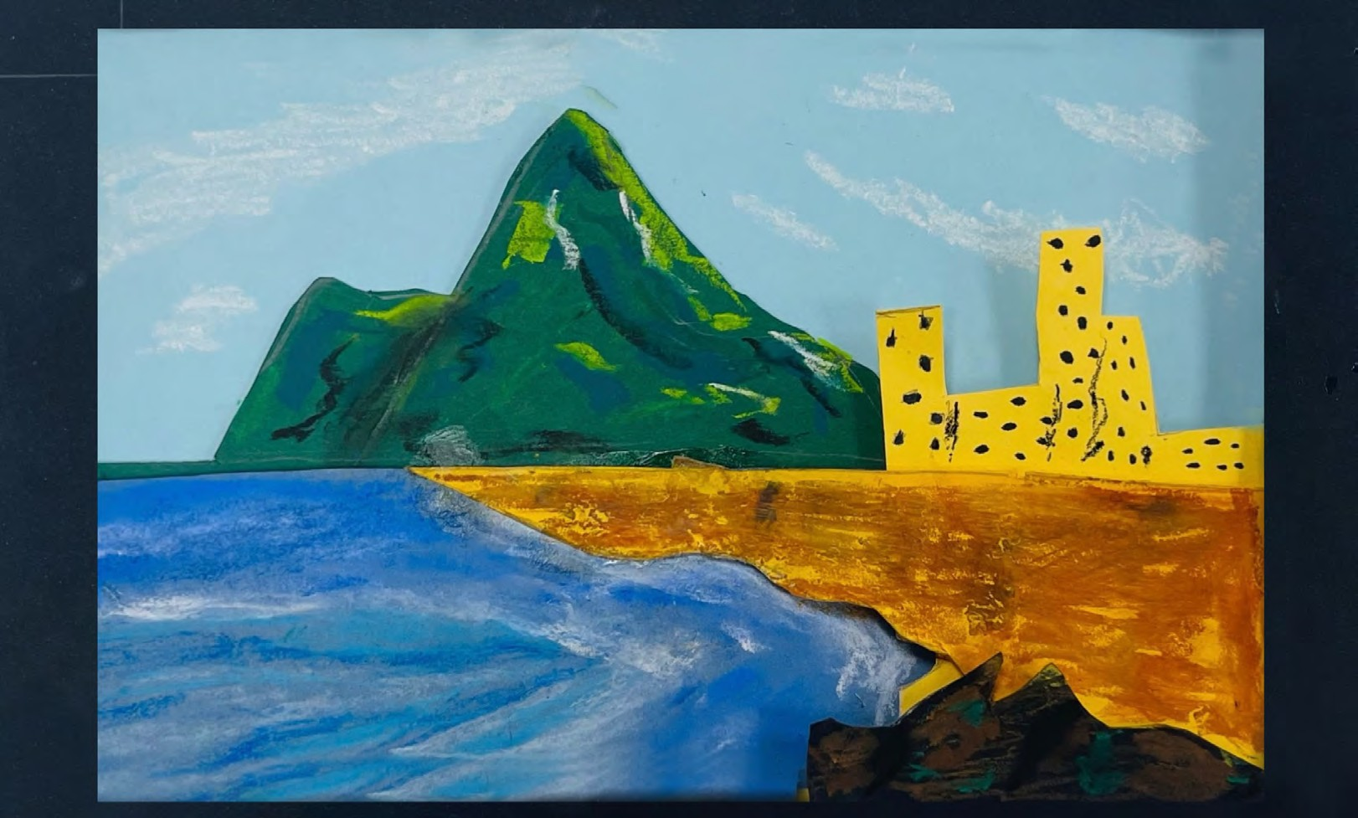

Slide 9
The Island Games Postcard Competition was an opportunity to allow the young people across our Islands to show how they saw their homes through a postcard format. We saw over 120 entries received, and through this have chosen 9 postcards to be printed and will be used to send messages of well wishes.
We hope you enjoy viewing all the entries compiled together from each Island that took part. Thank you to each person who submitted an entry – you have given us a fantastic insight into your Island to share with our fellow Islanders.

Slide 10

GUERNSEY
Le Mare De Carteret High School - year 7 and 8
+ M Cook – Ladies College (aged 12)

Slide 11
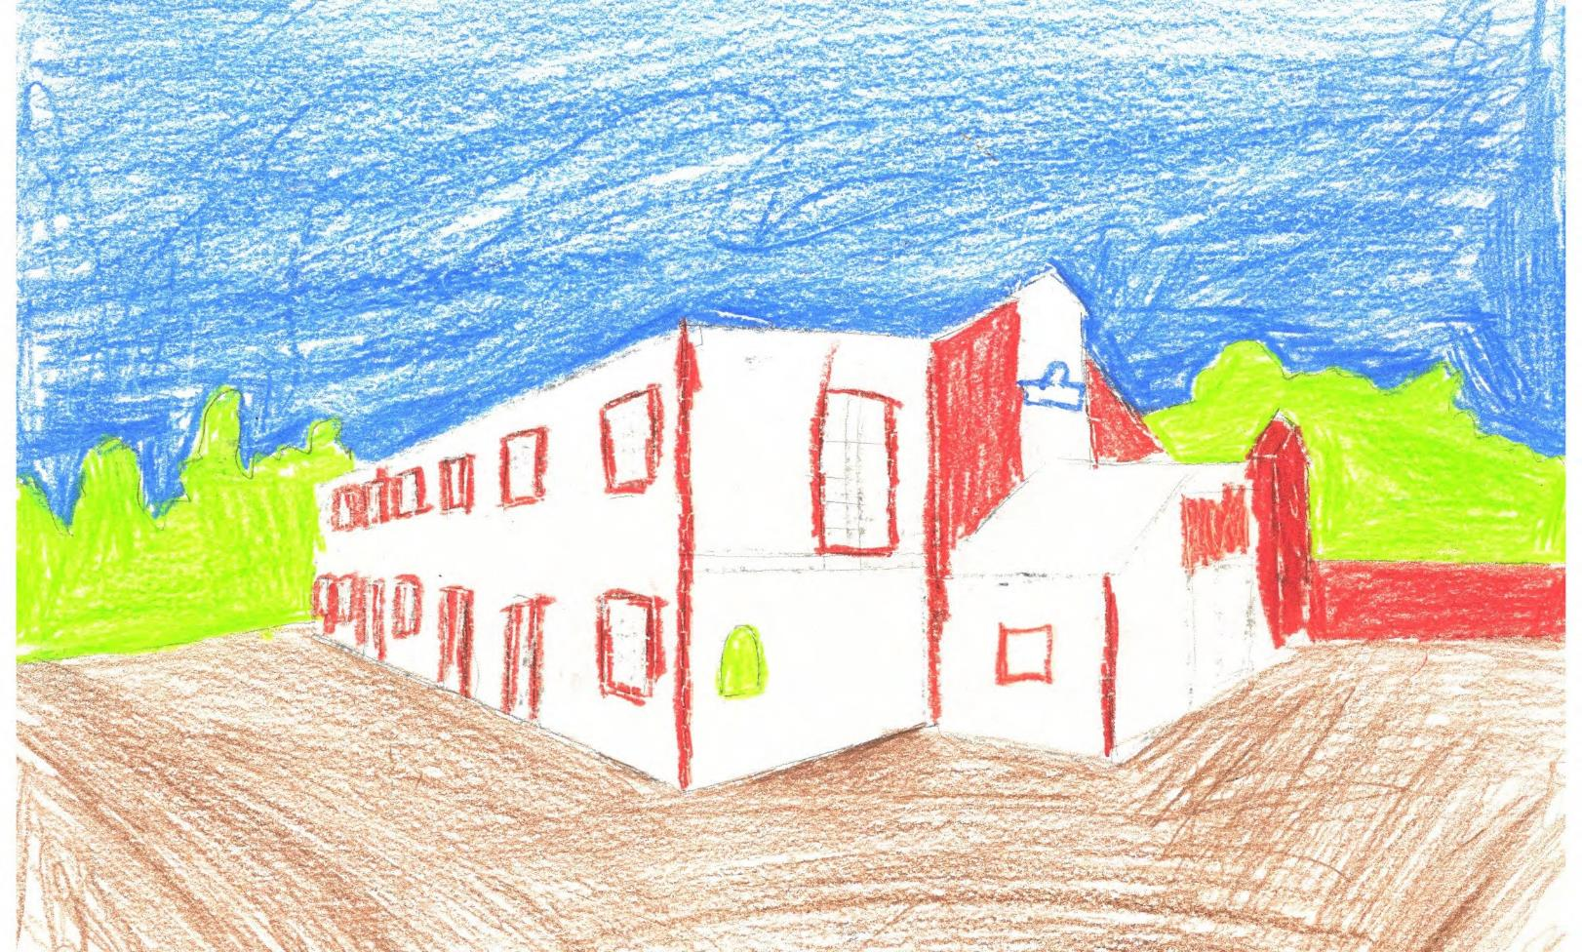

Slide 12
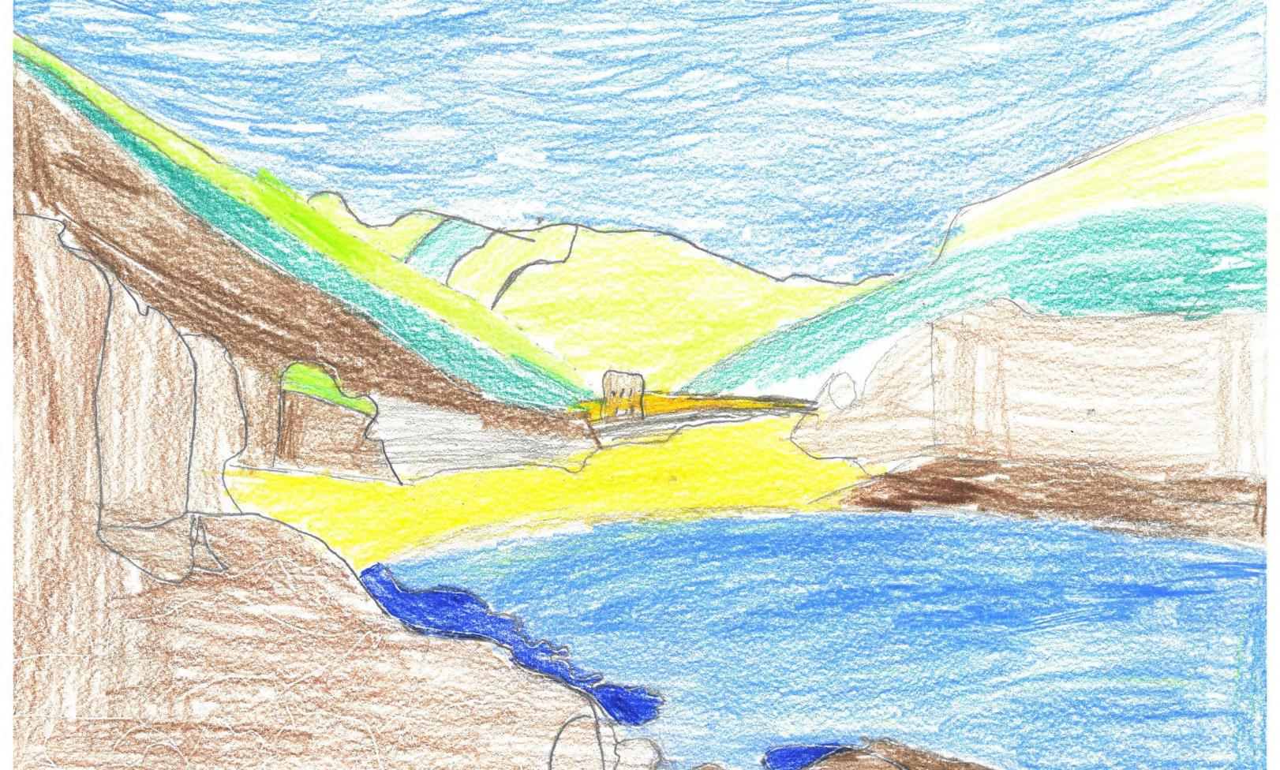

Slide 13
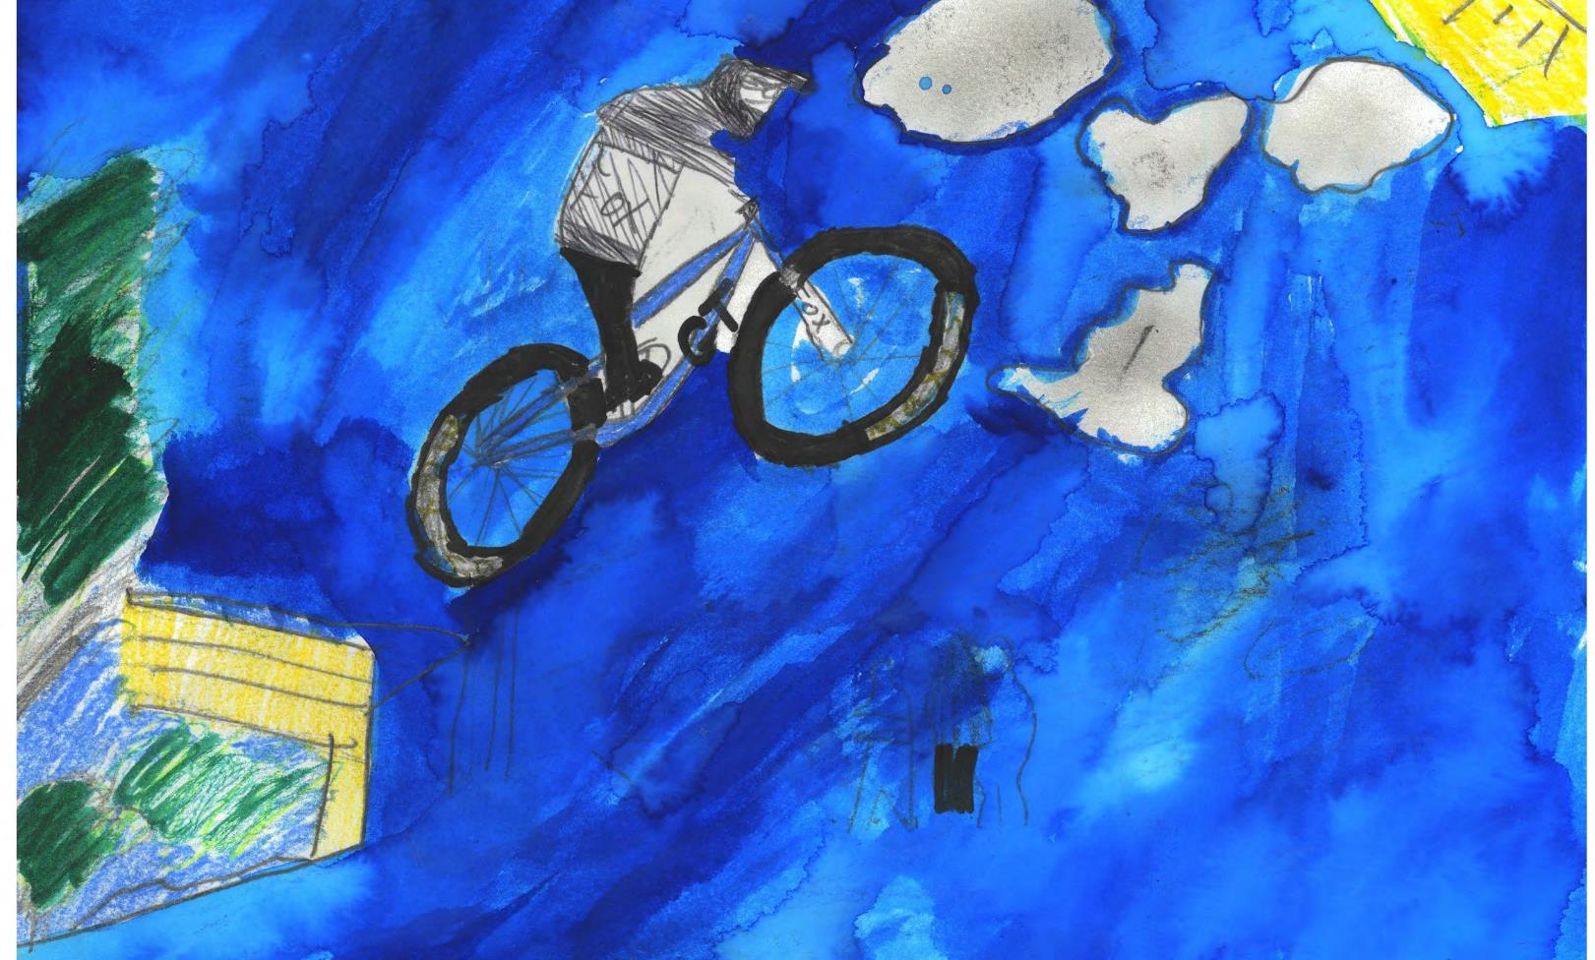

Slide 14
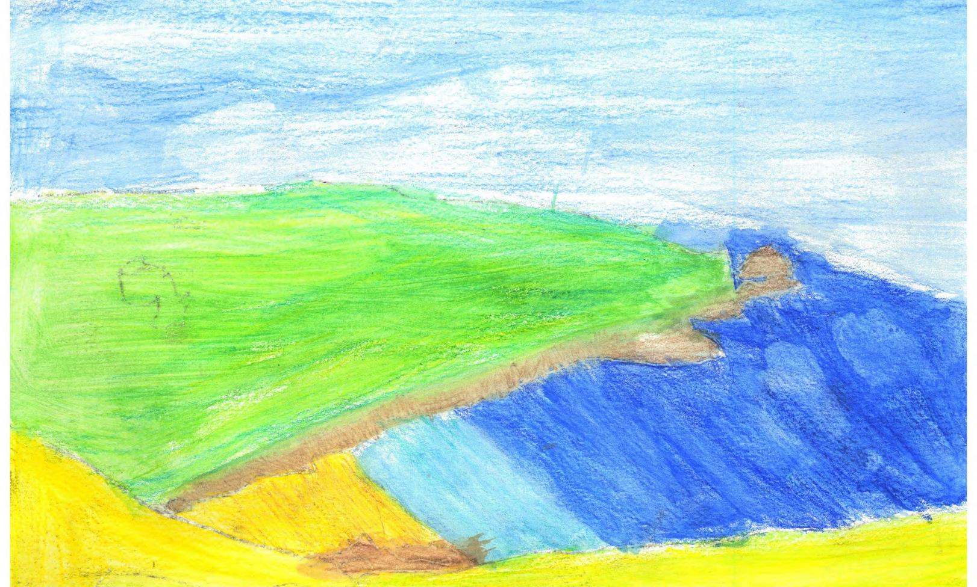

Slide 15
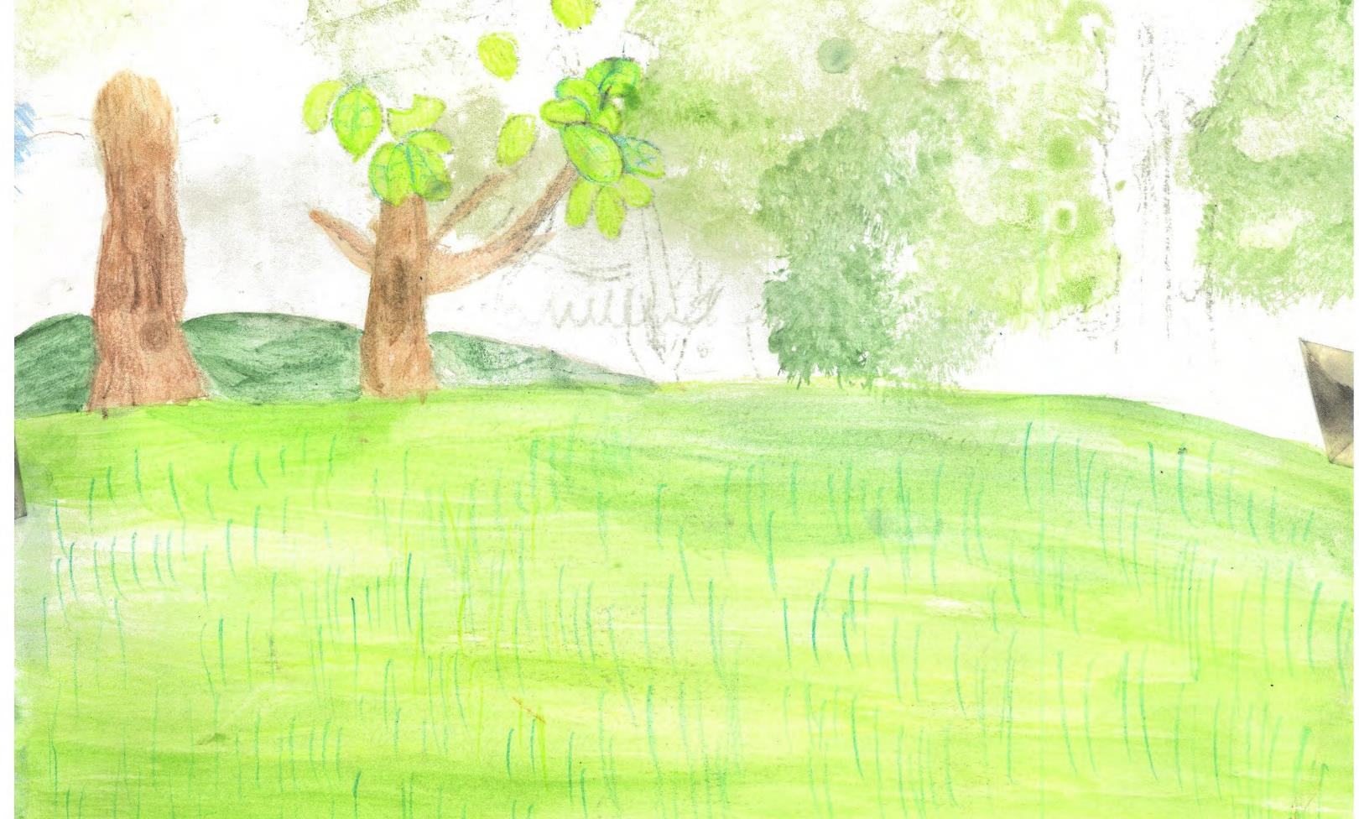

Slide 16
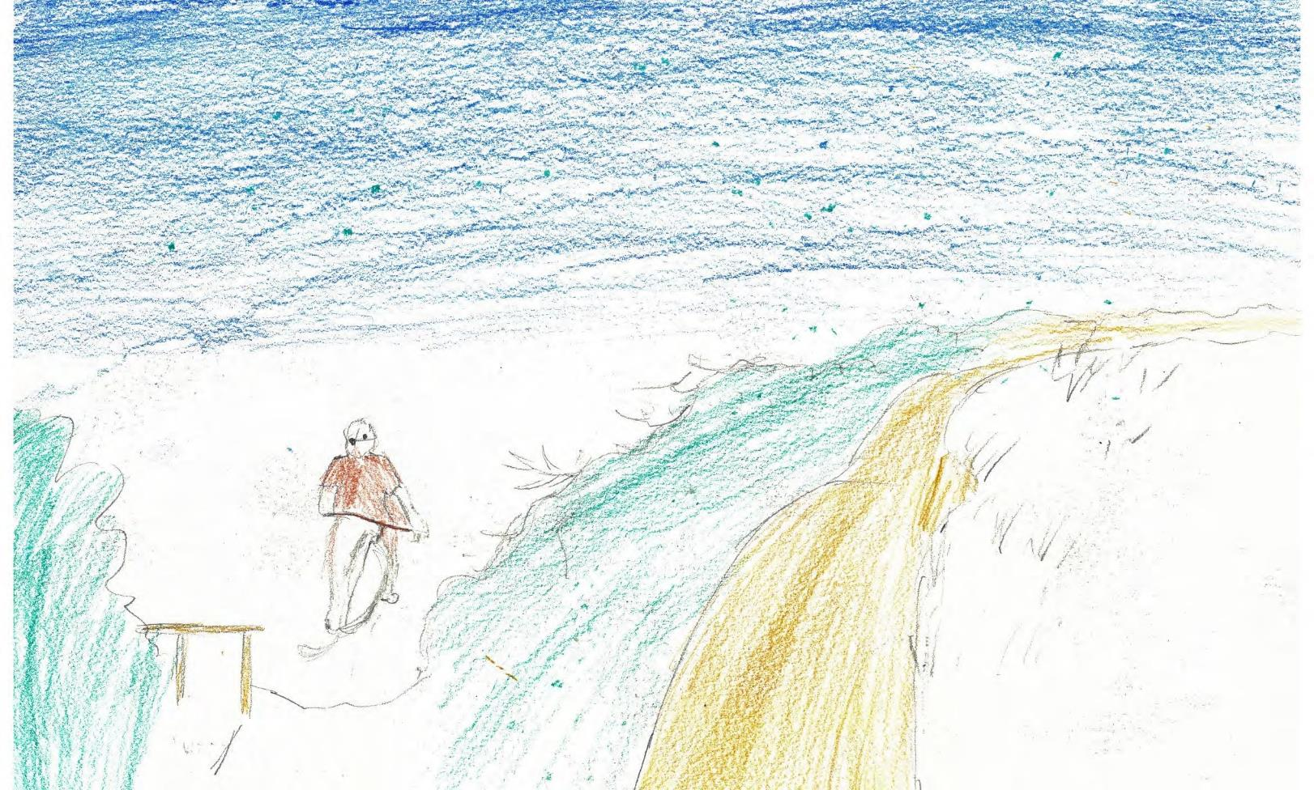

Slide 17
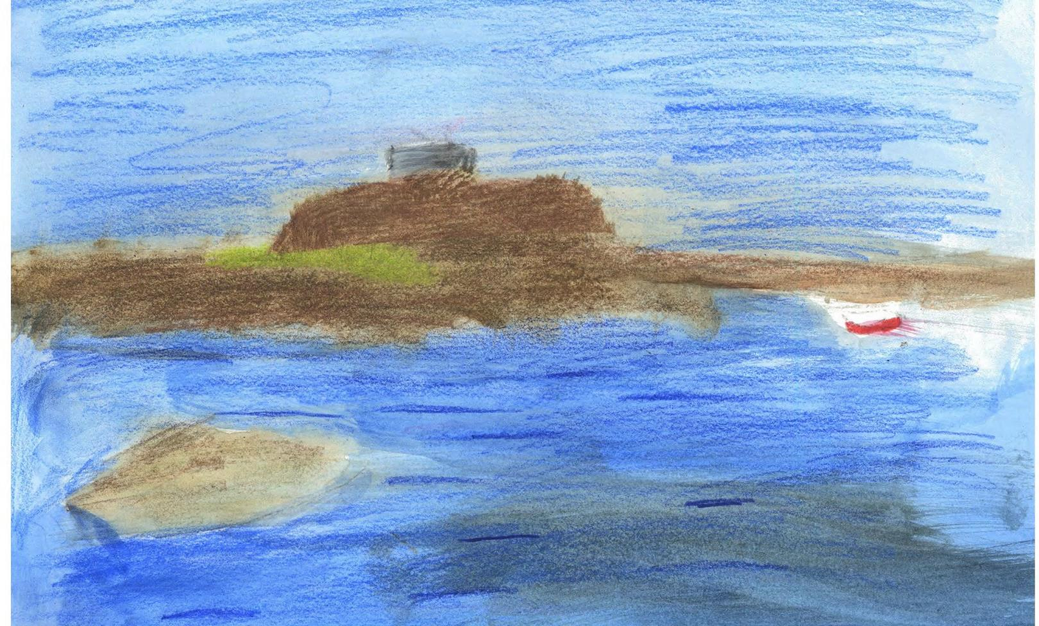

Slide 18
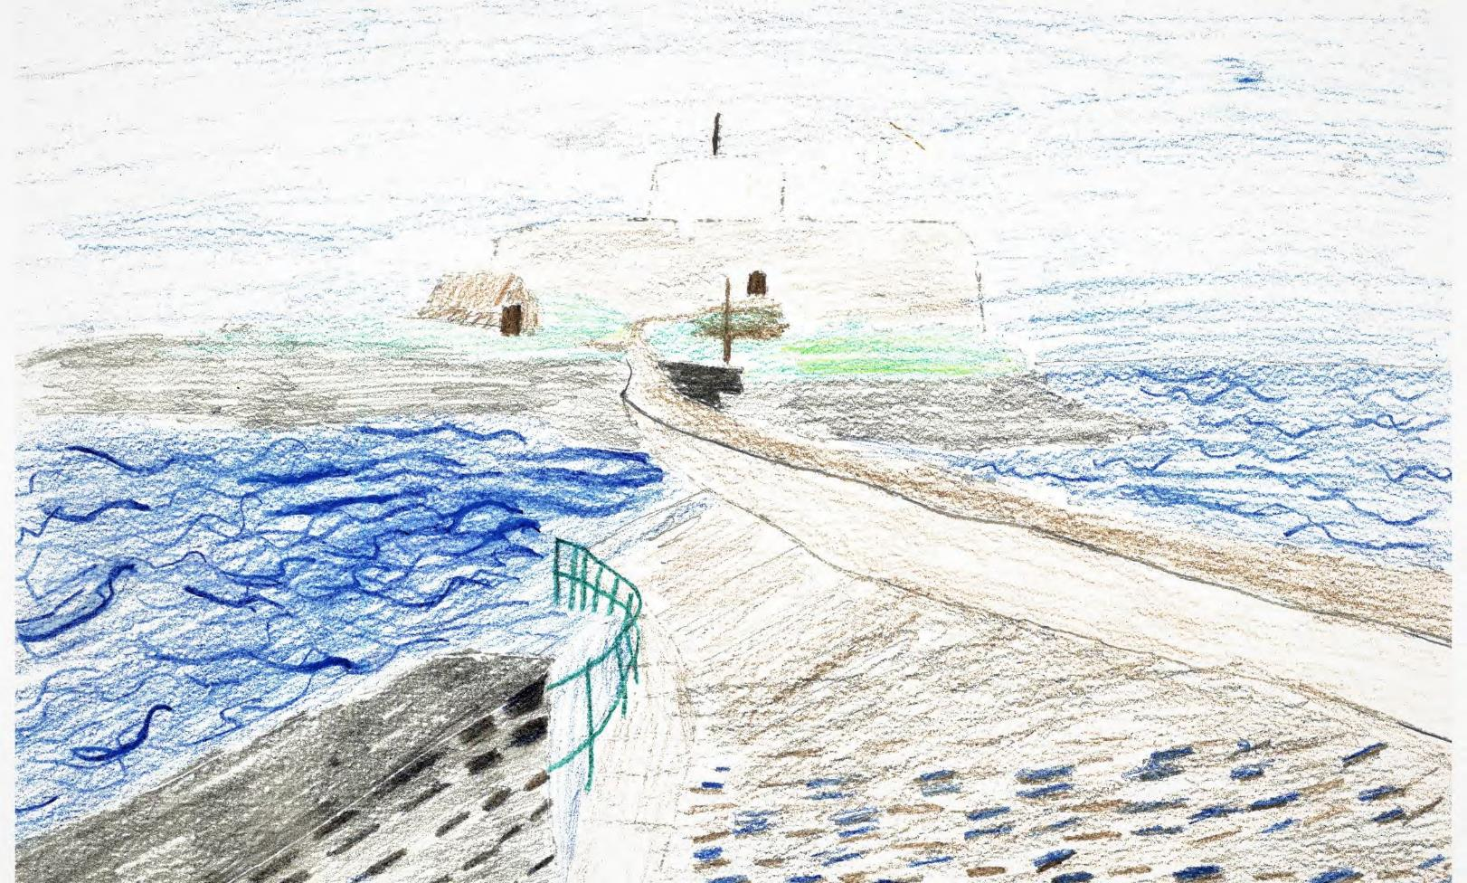

Slide 19
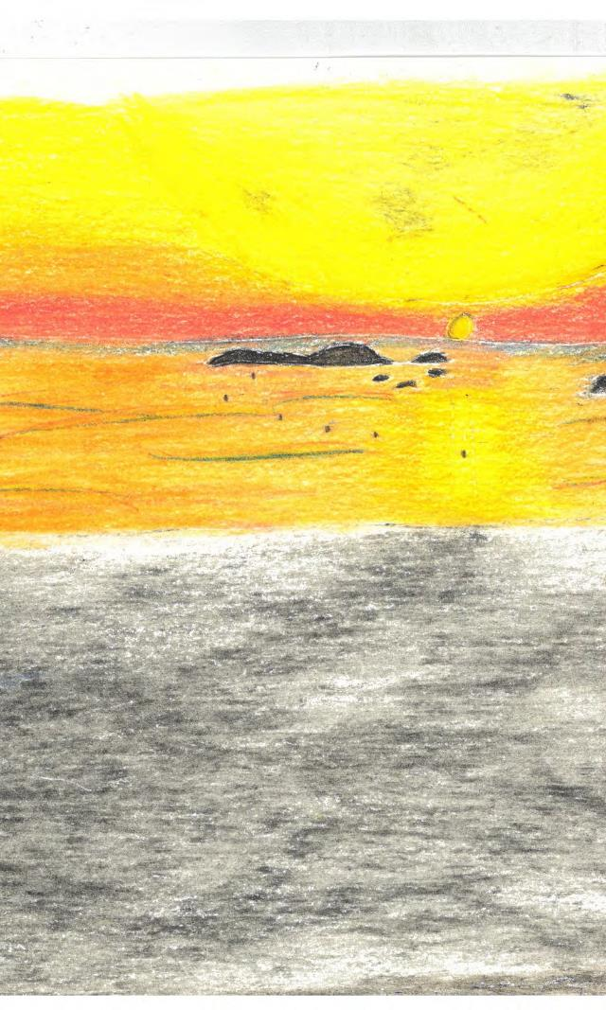

Slide 20
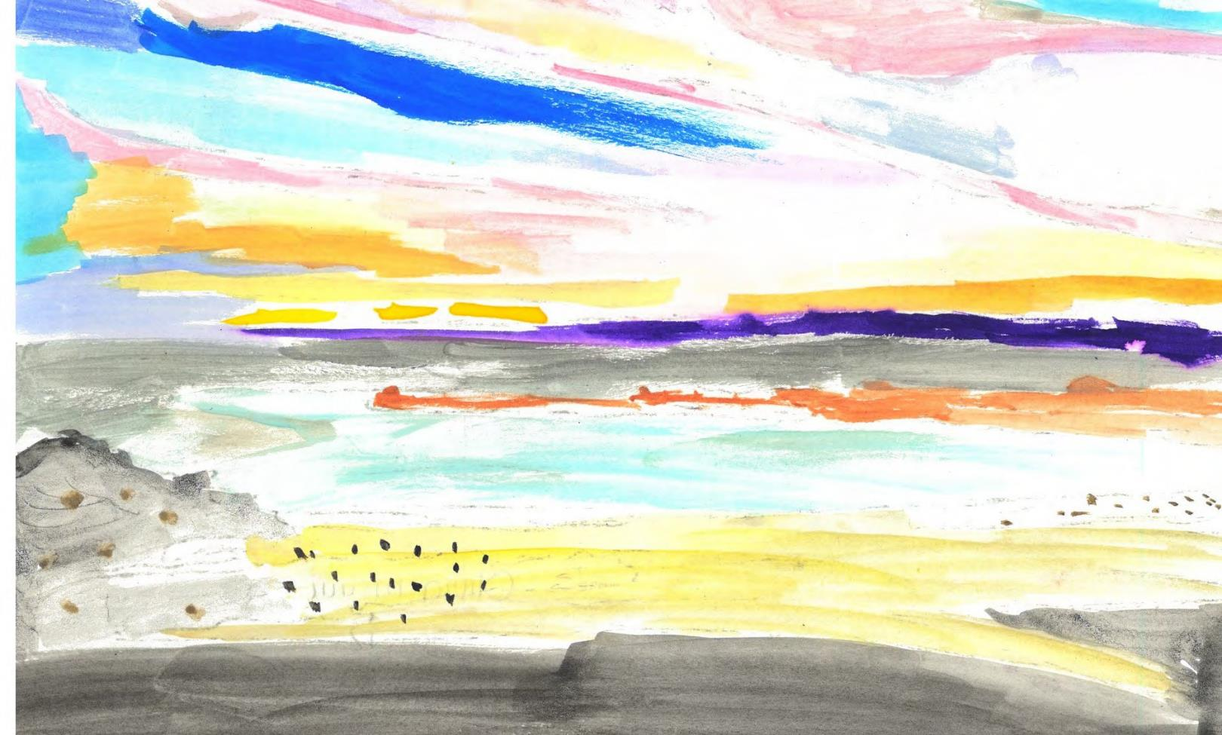

Slide 21
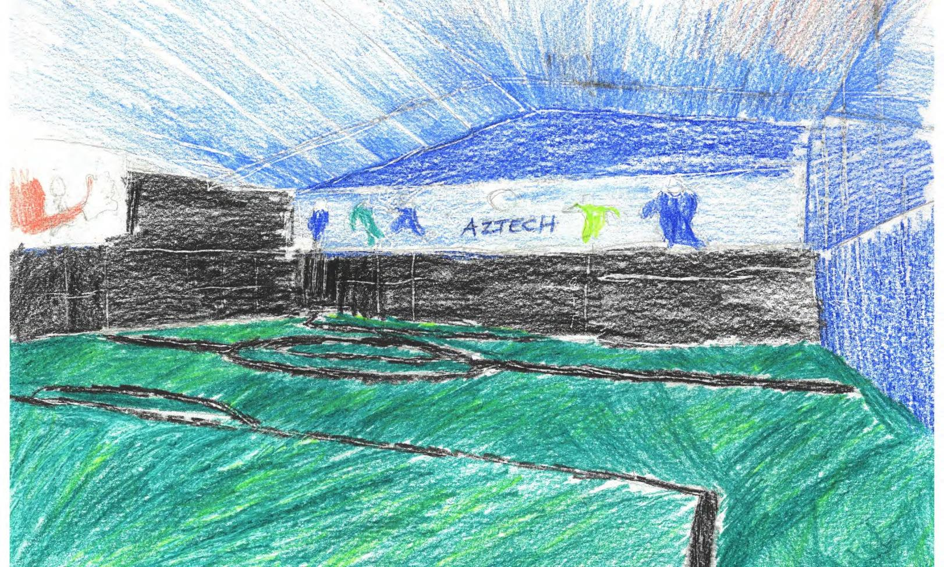

Slide 22
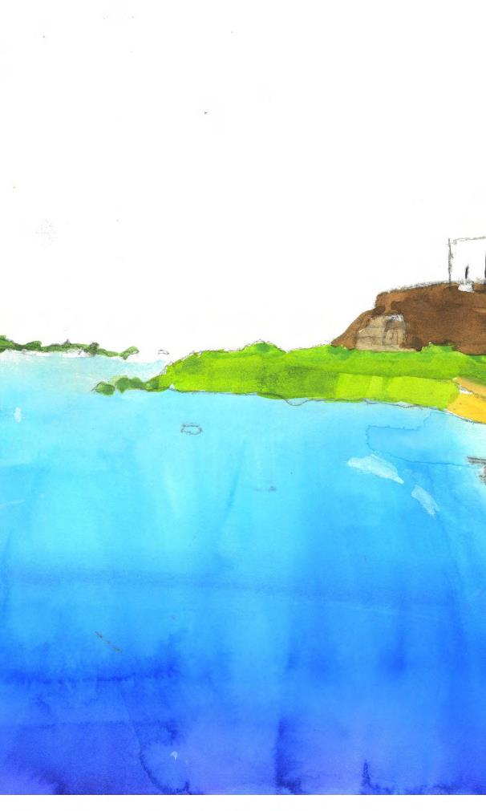

Slide 23
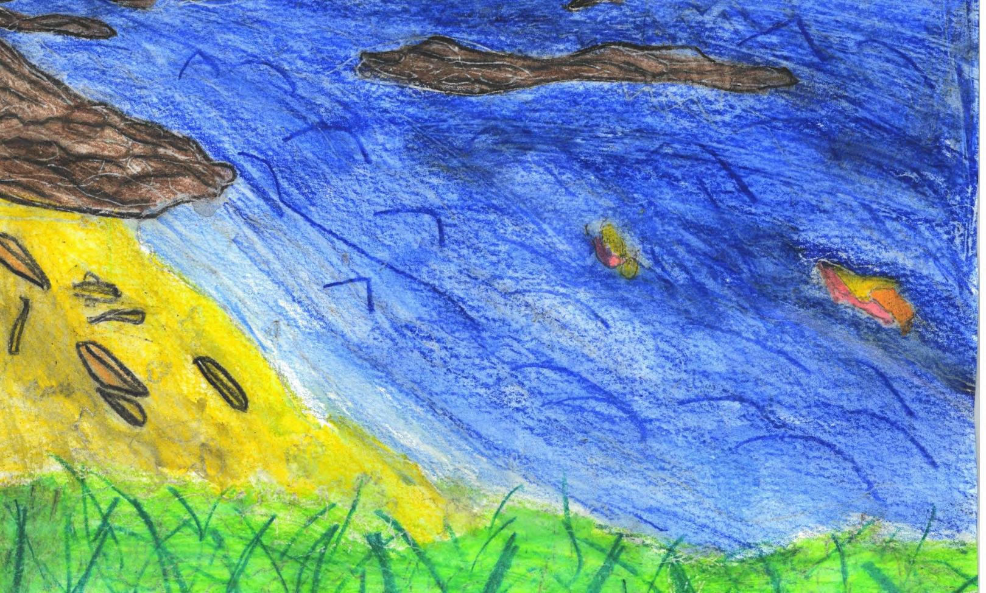

Slide 24
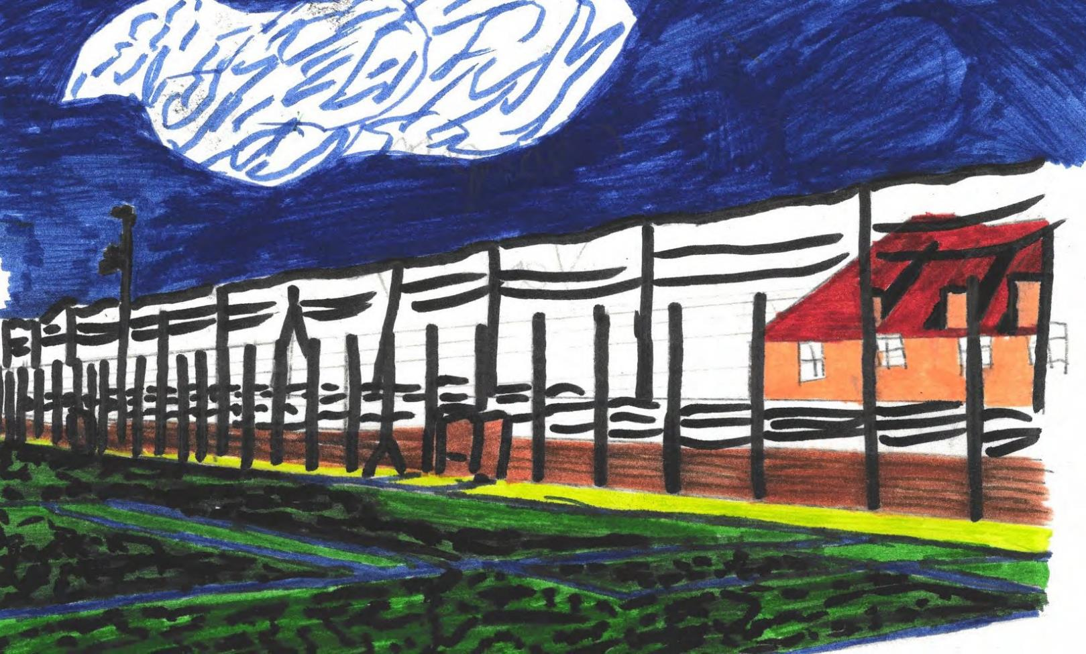

Slide 25
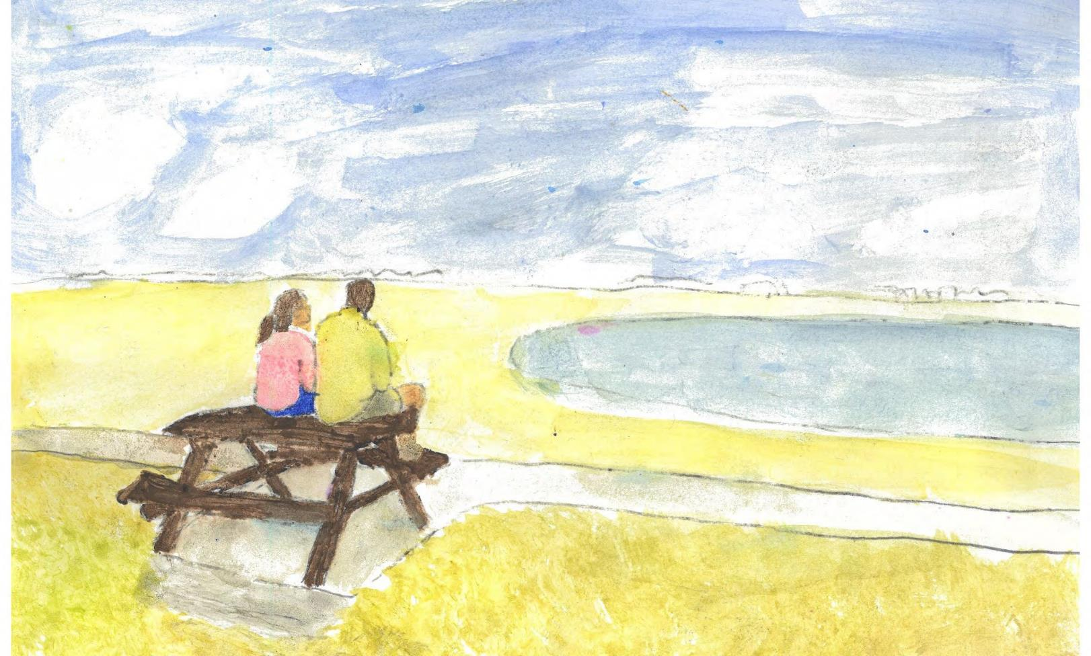

Slide 26
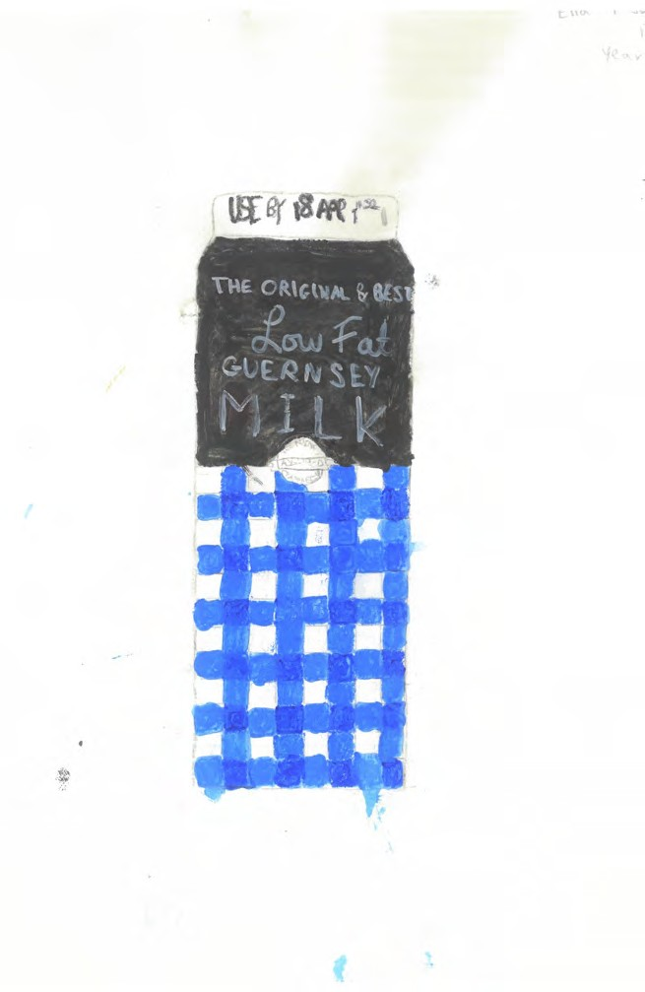

Slide 27
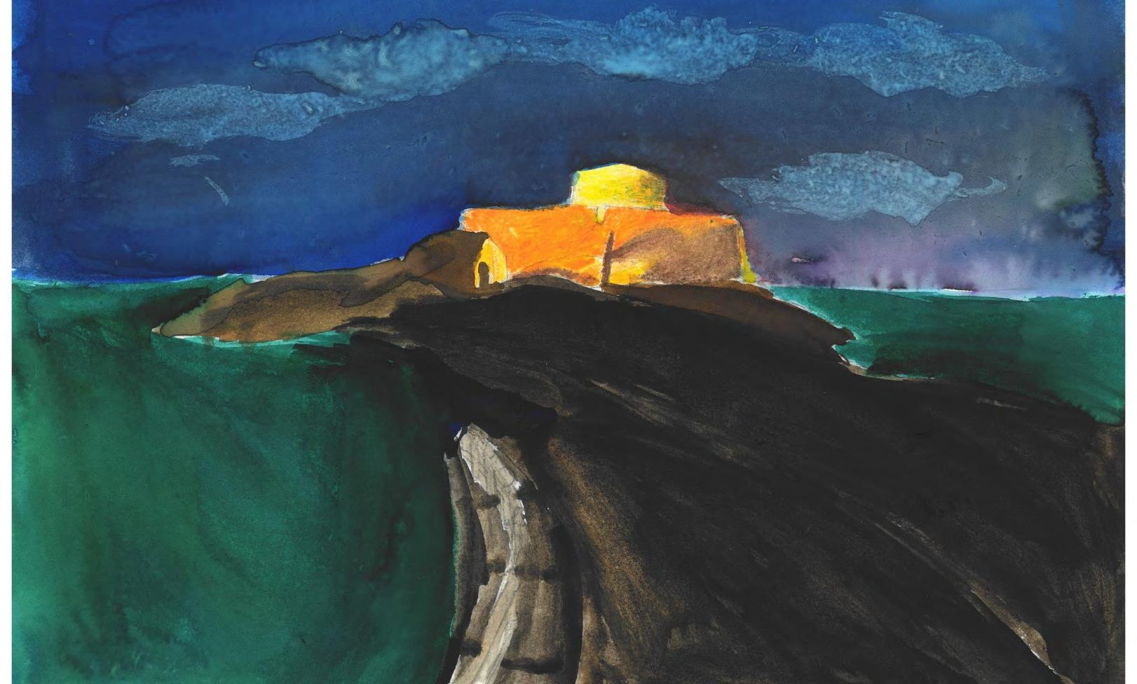

Slide 28
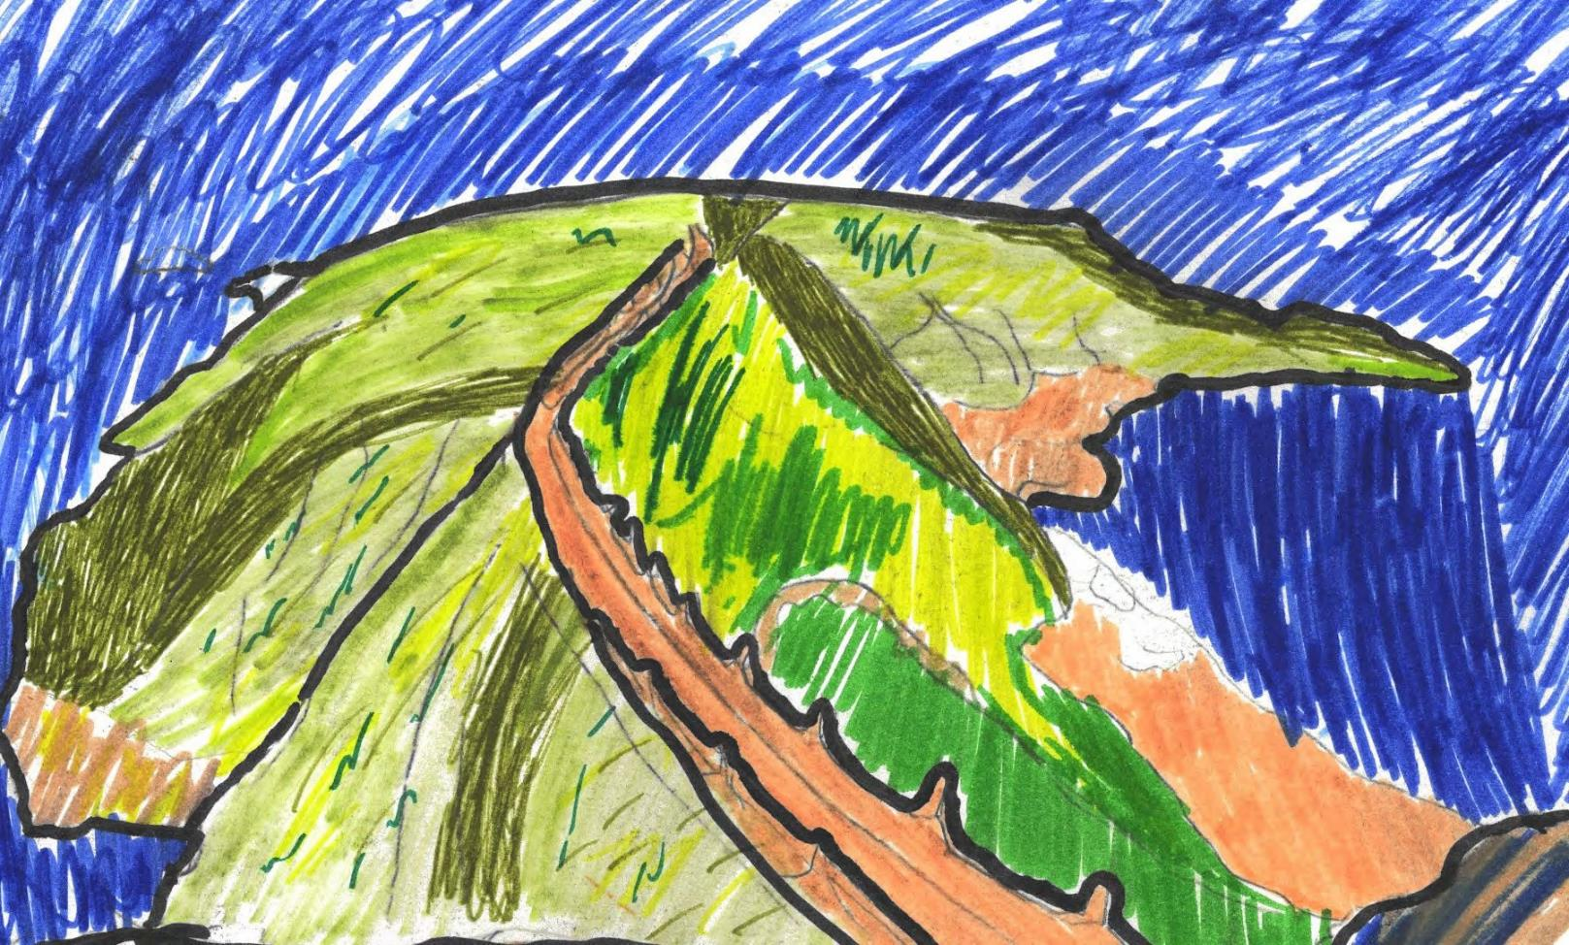

Slide 29
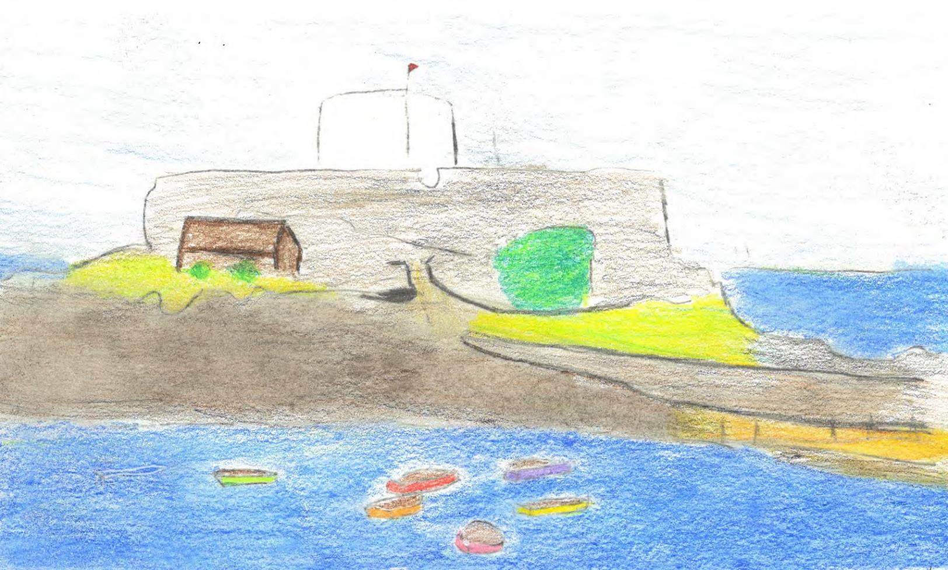

Slide 30
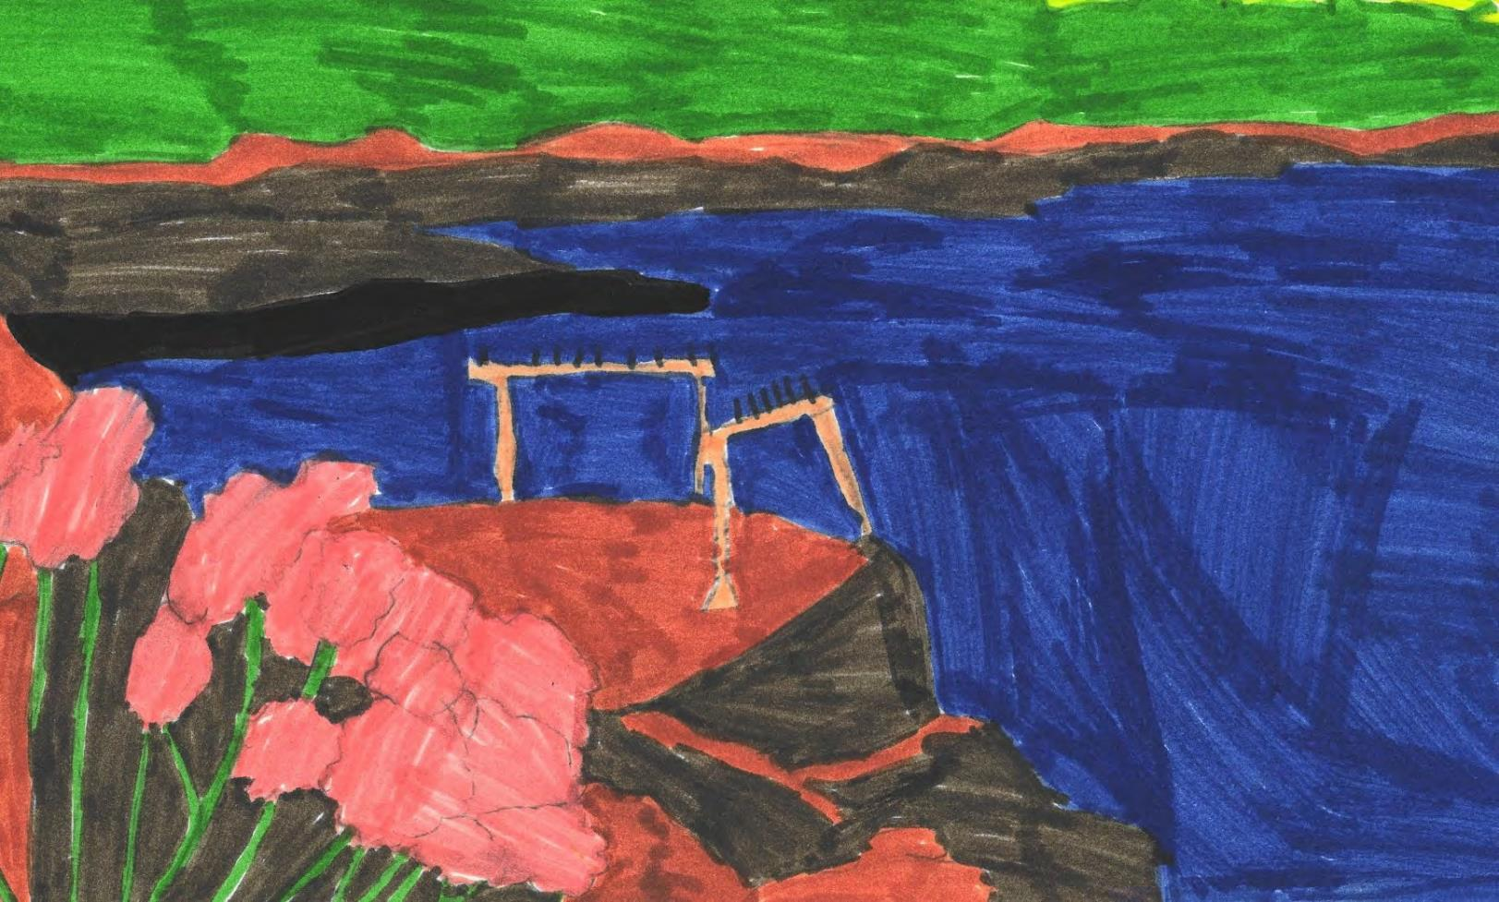

Slide 31
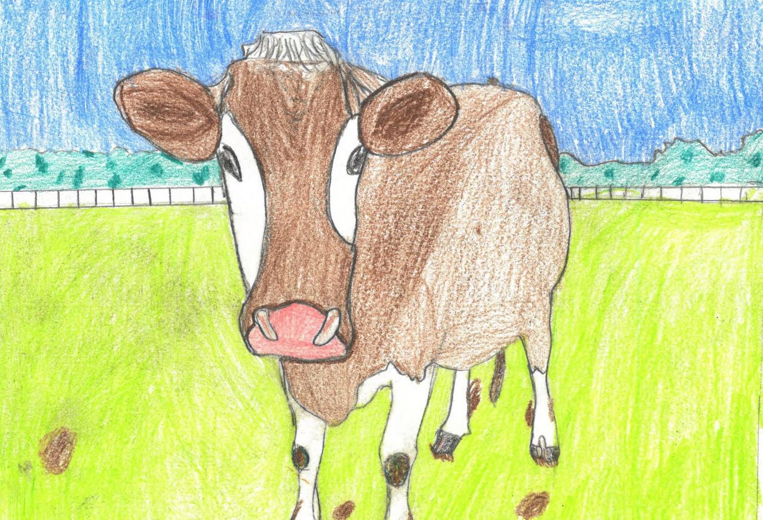

Slide 32
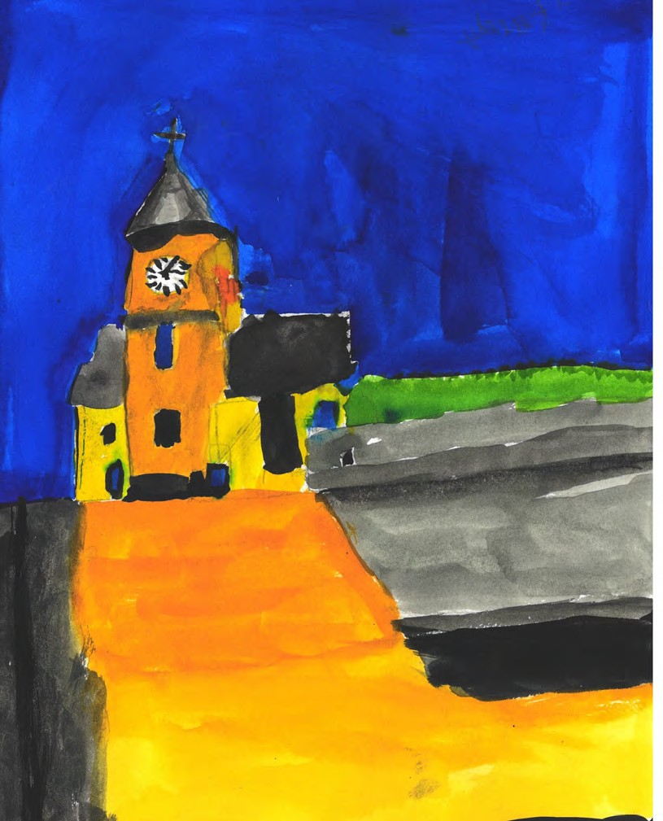

Slide 33
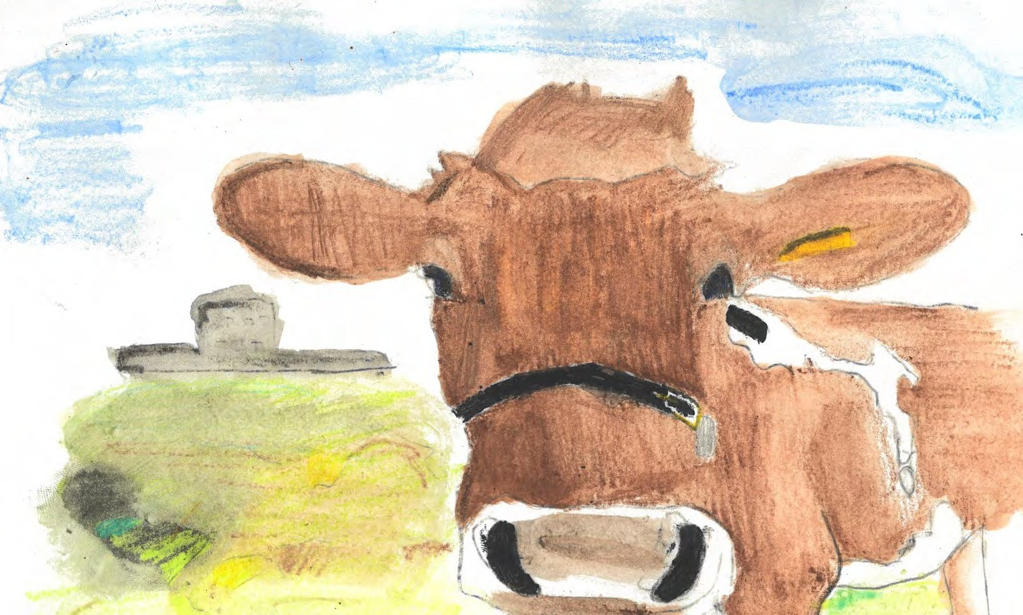

Slide 34
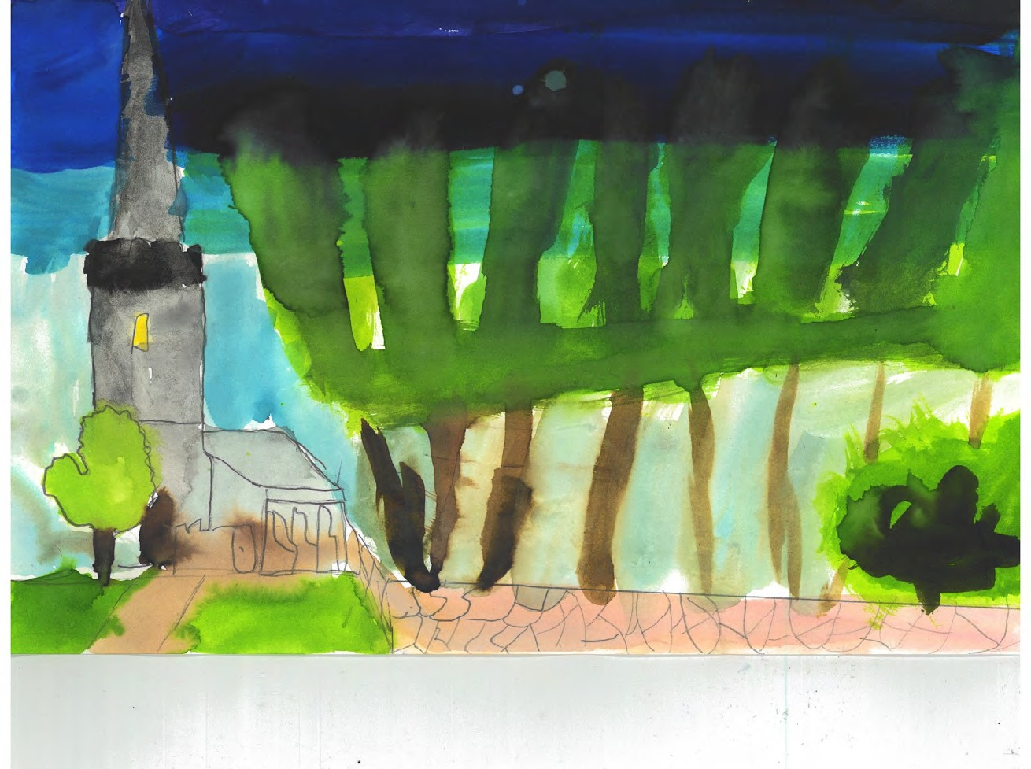

Slide 35
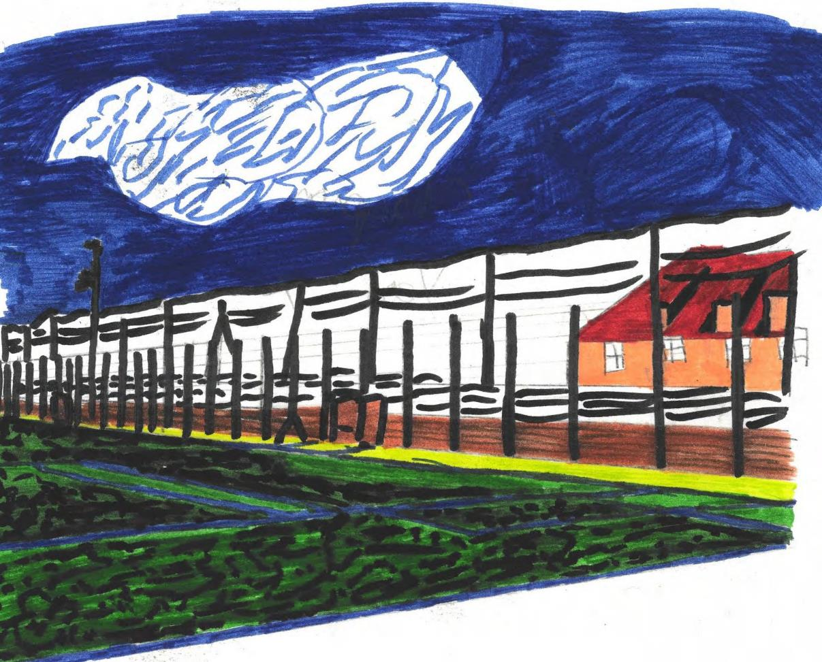

Slide 36
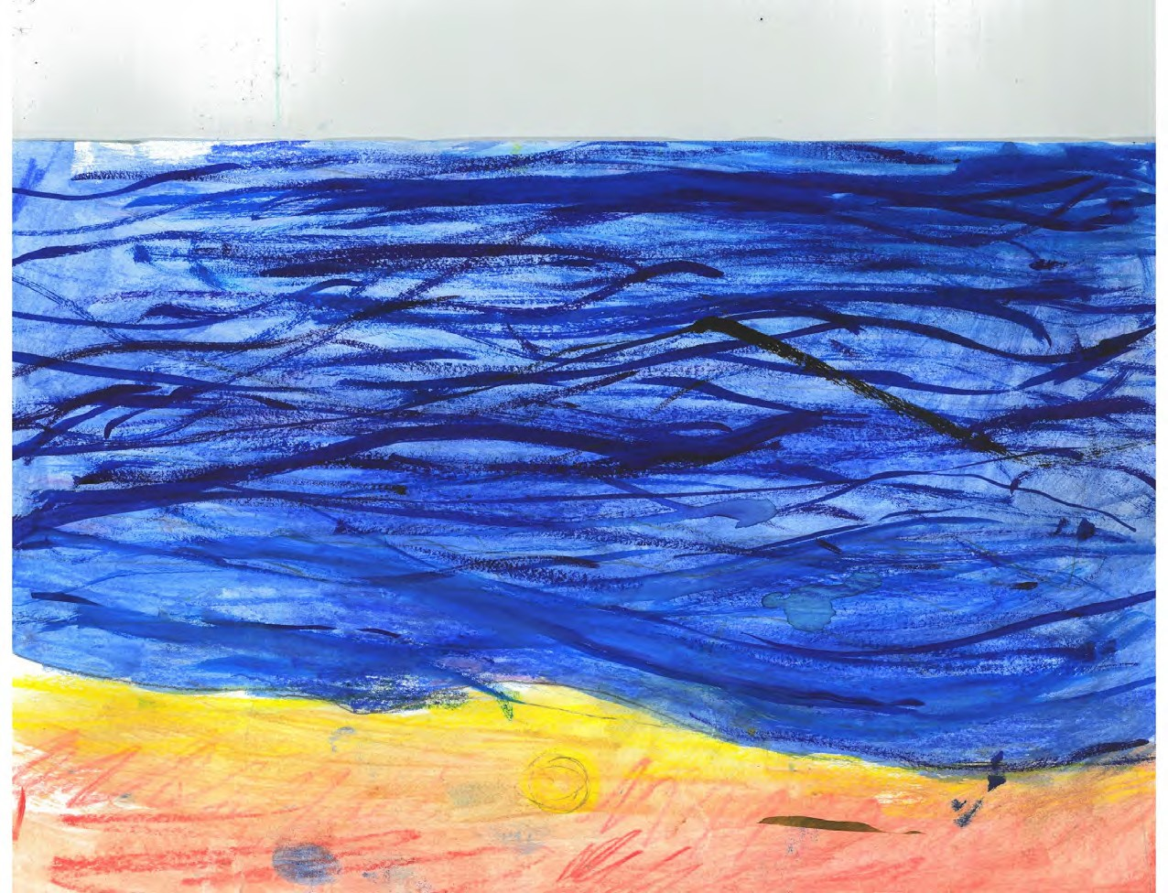

Slide 37
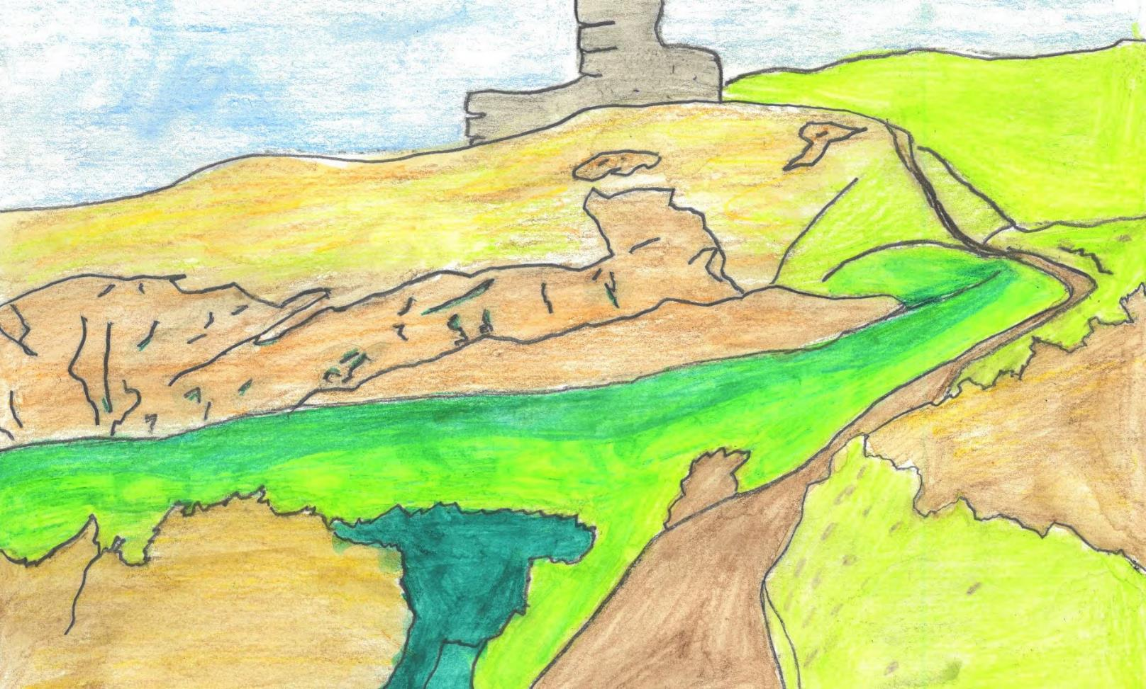

Slide 38
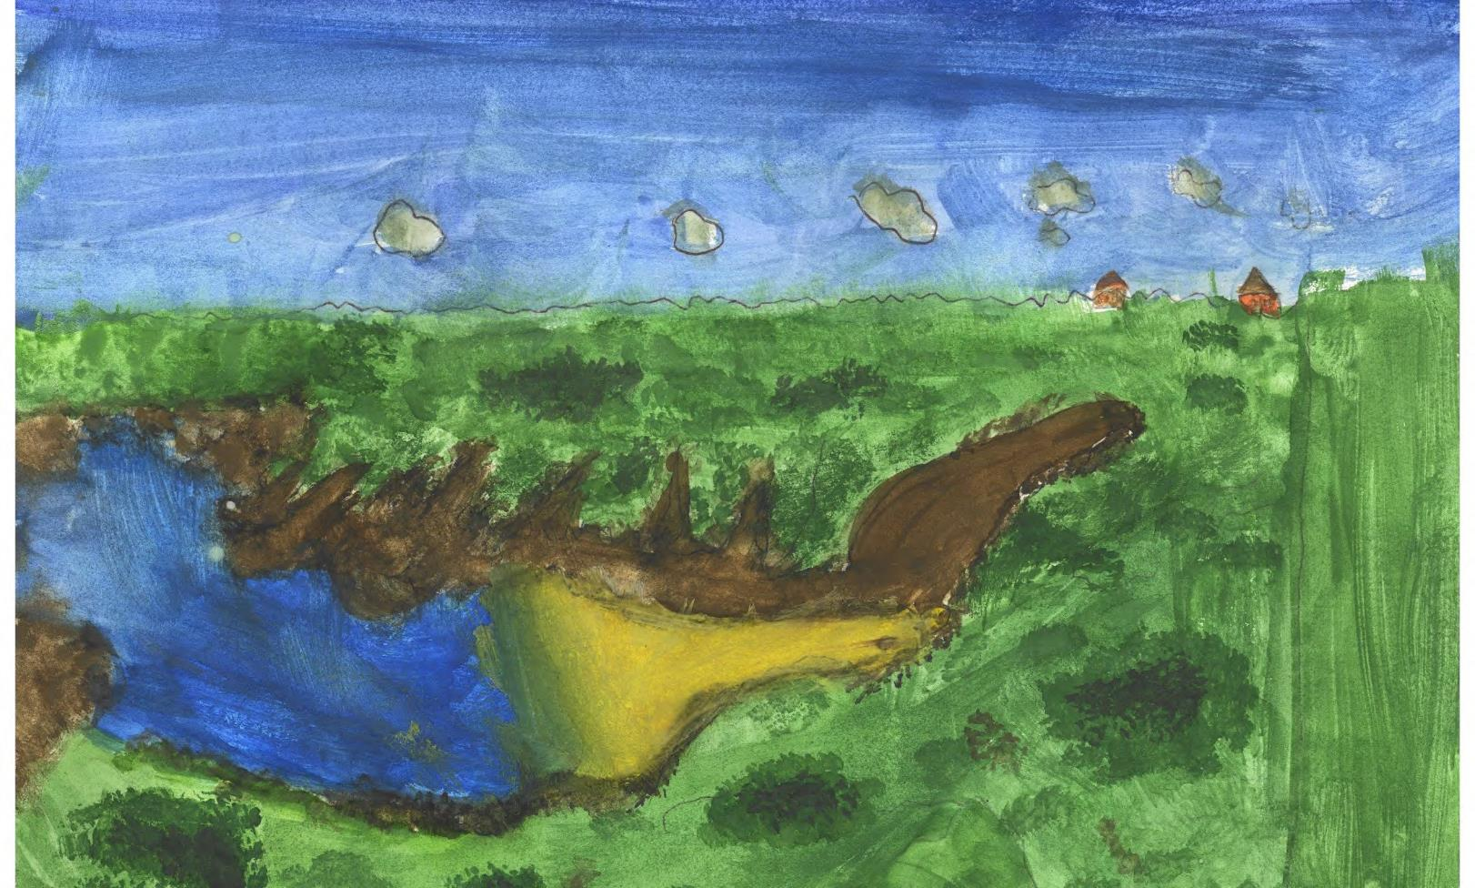

Slide 39
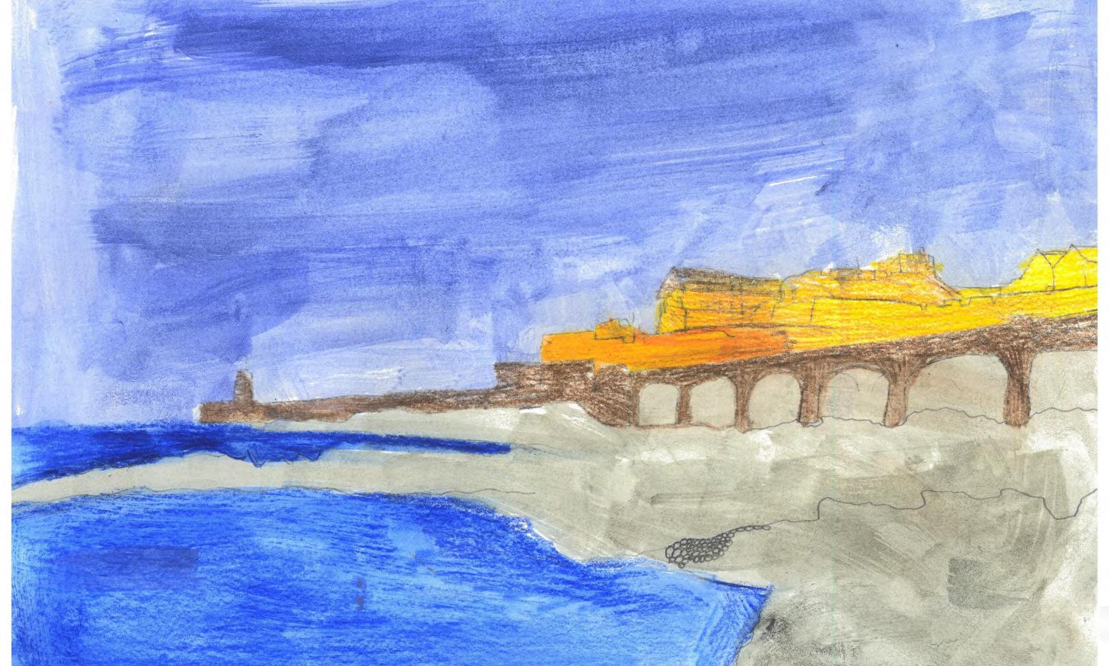

Slide 40
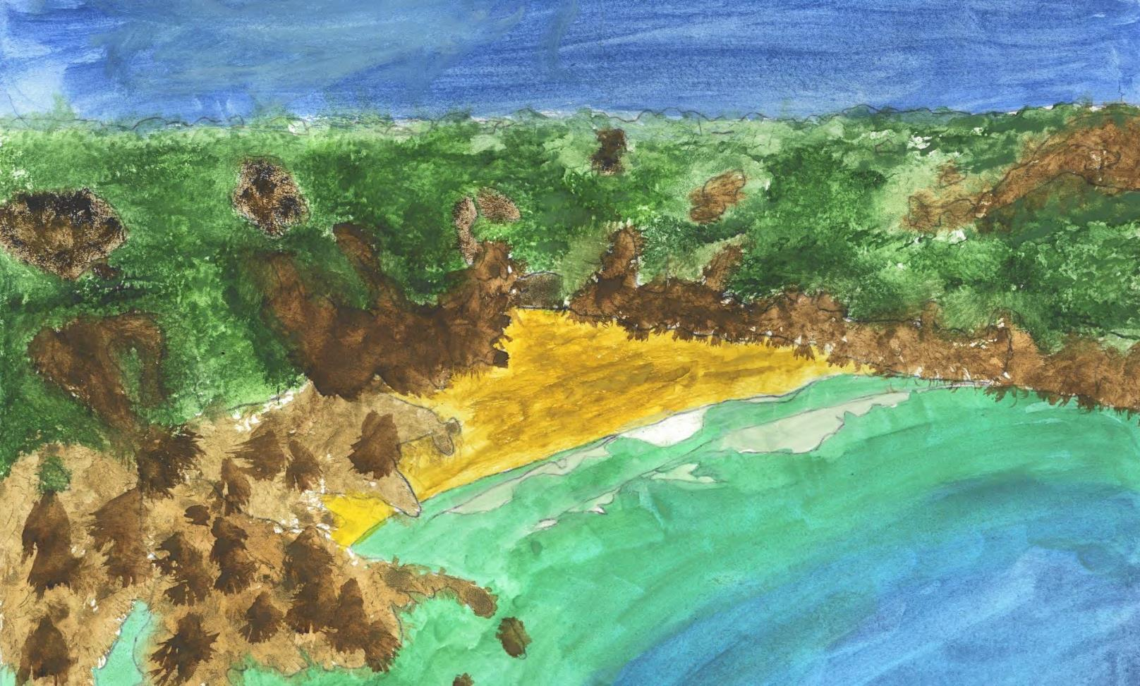

Slide 41
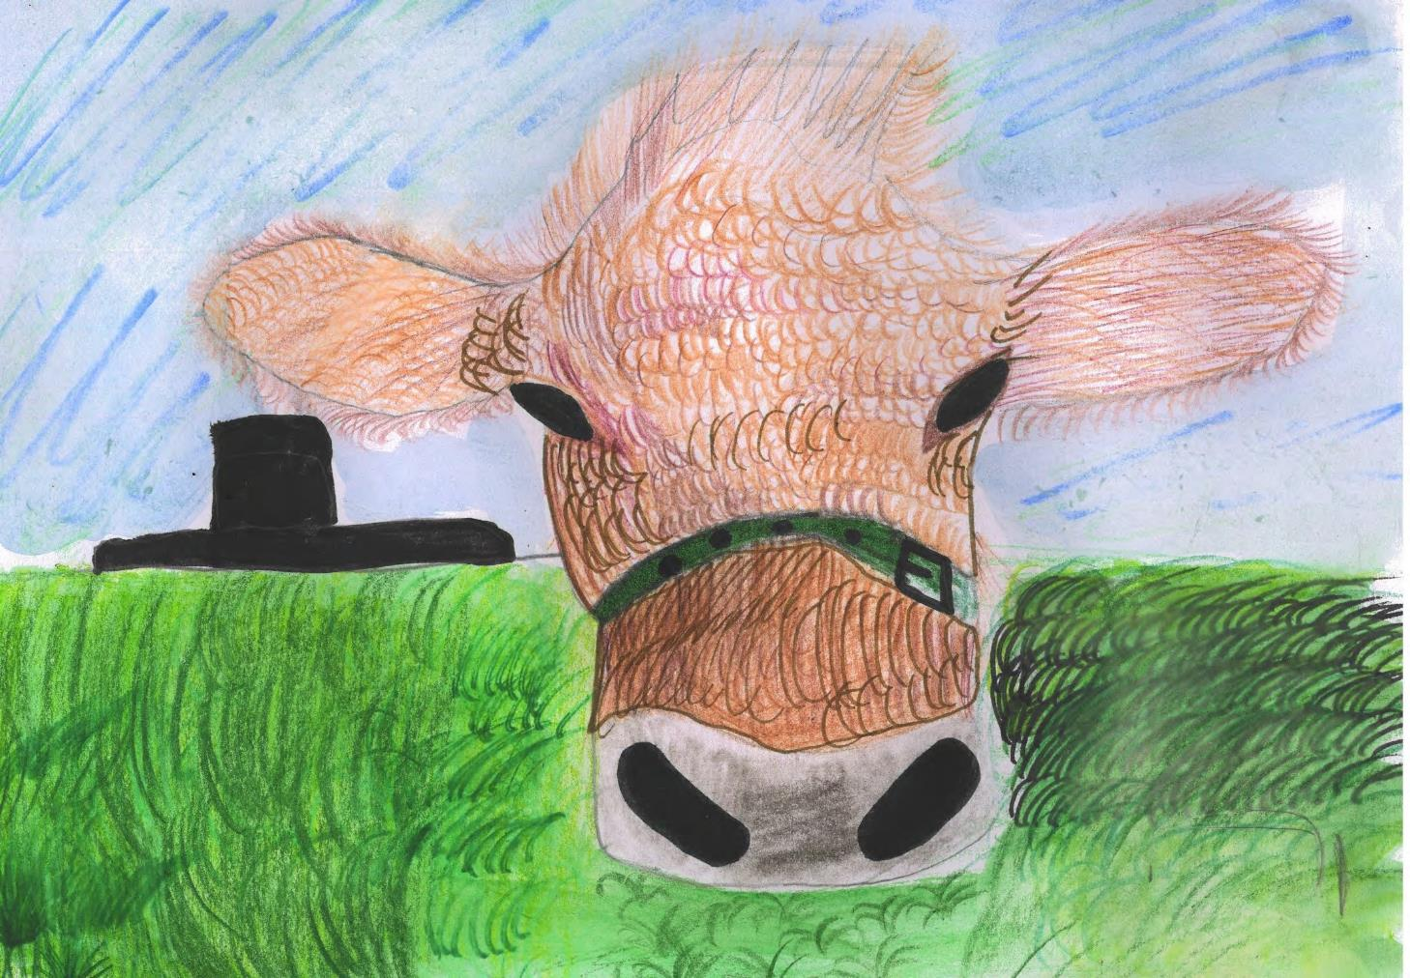

Slide 42
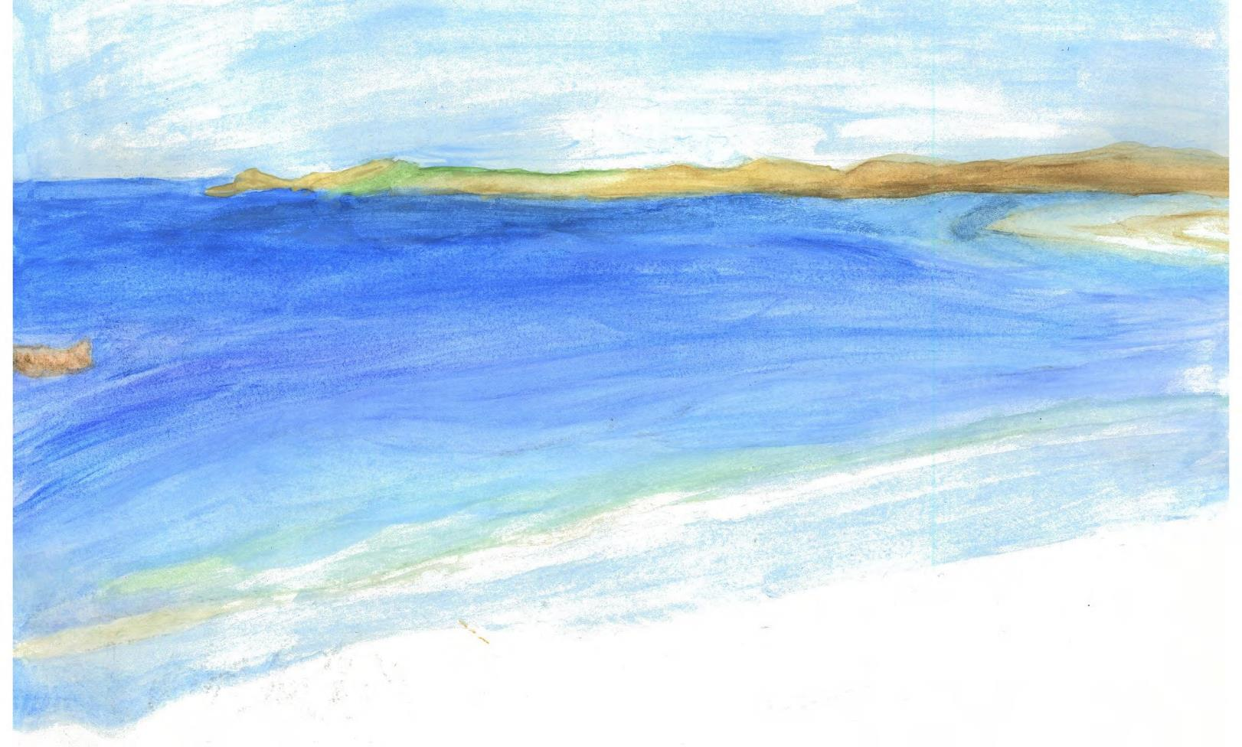

Slide 43
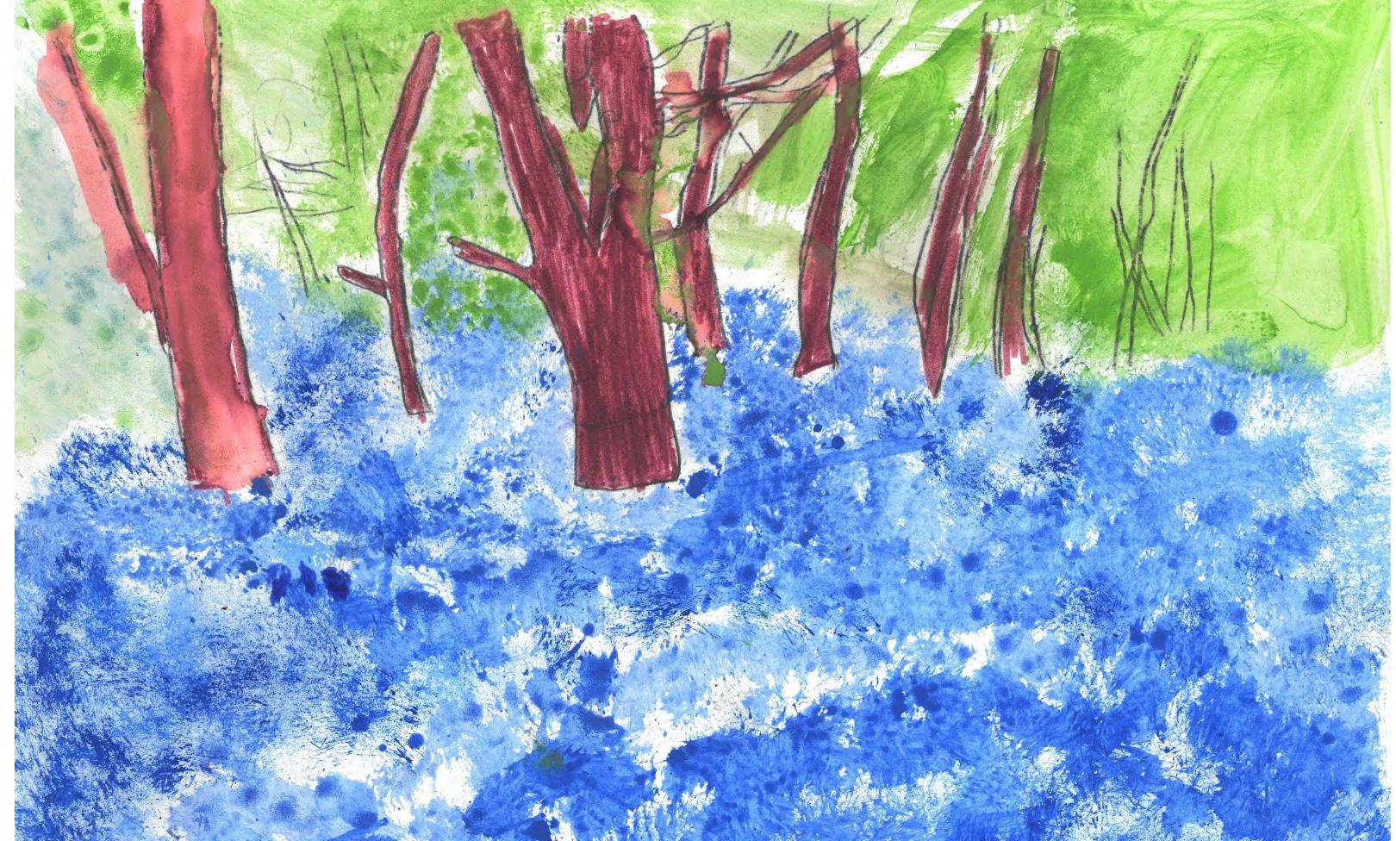

Slide 44
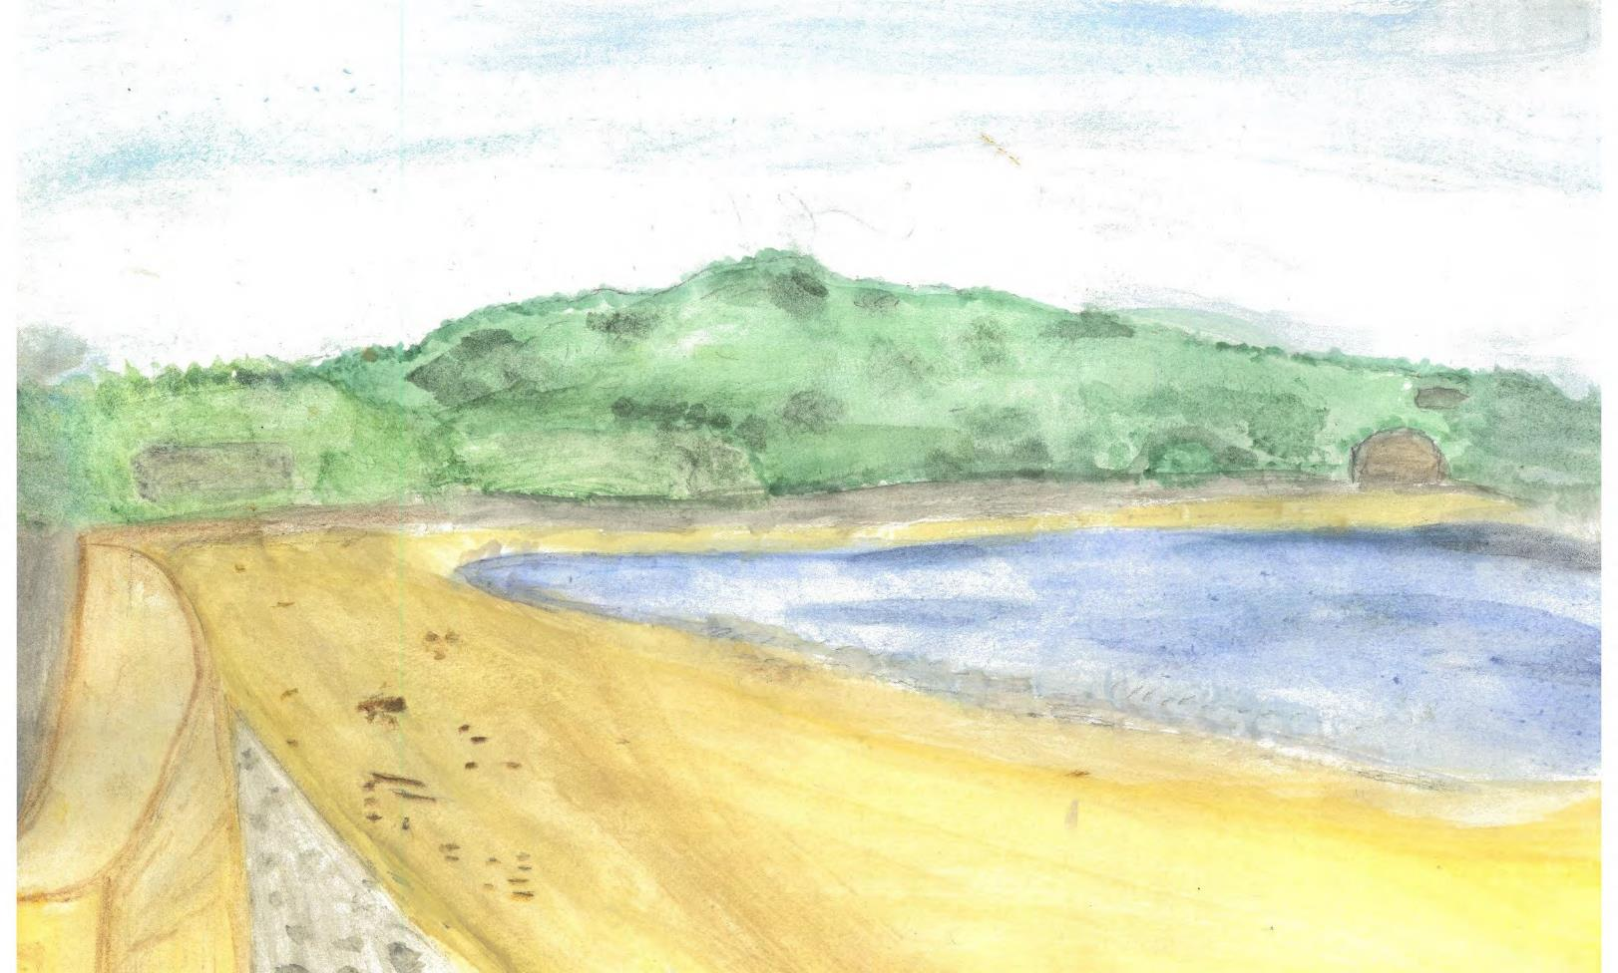

Slide 45
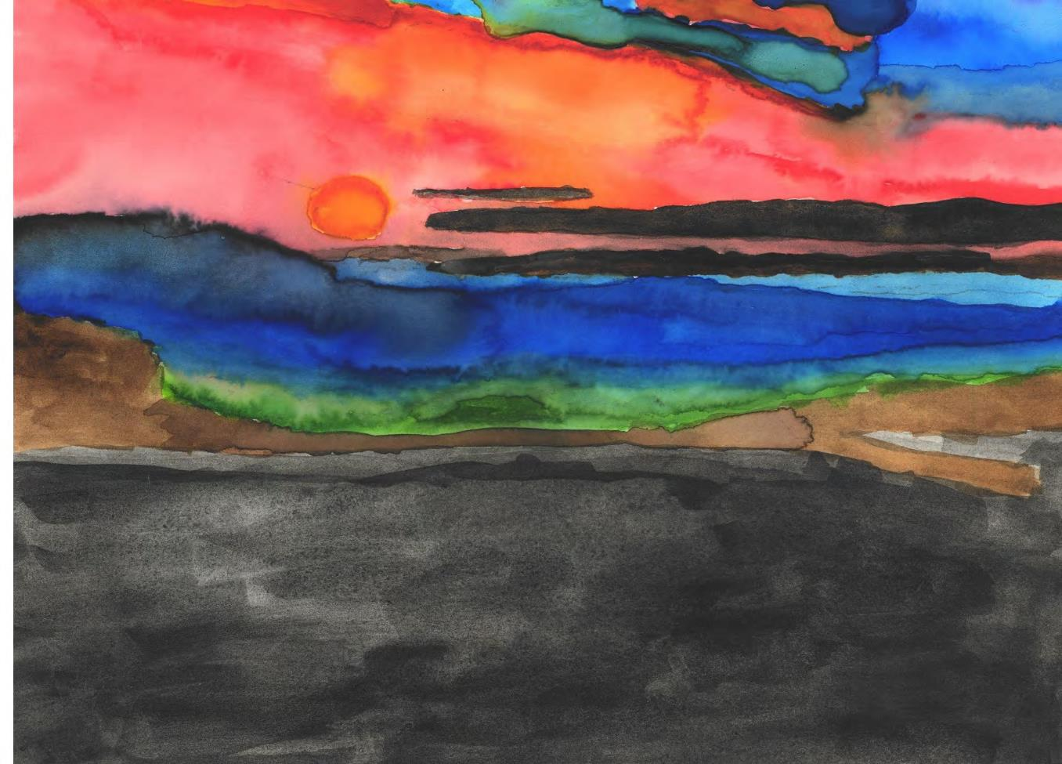

Slide 46
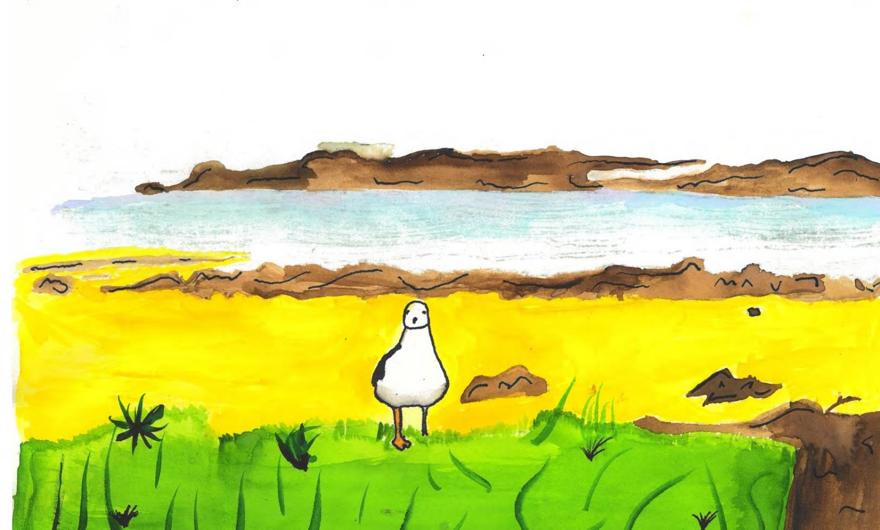

Slide 47
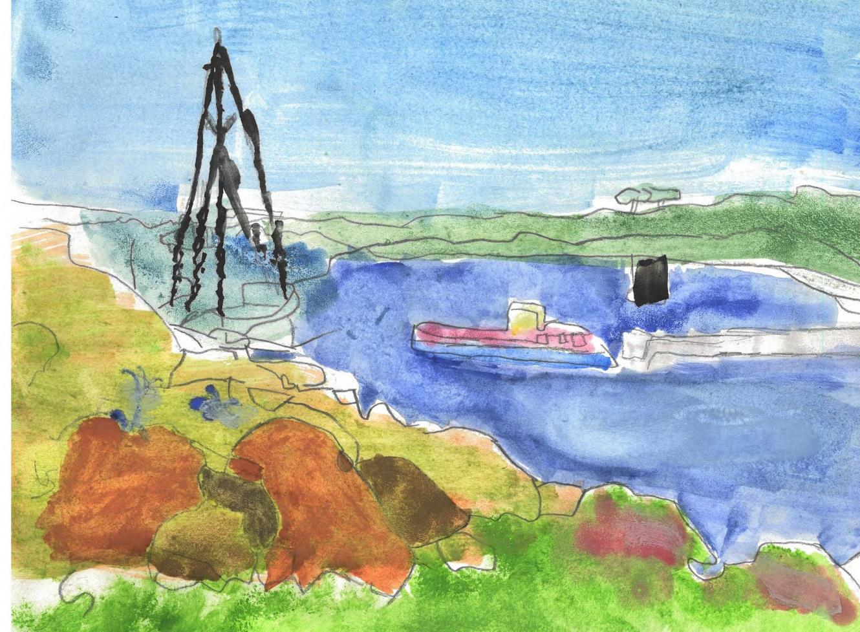

Slide 48
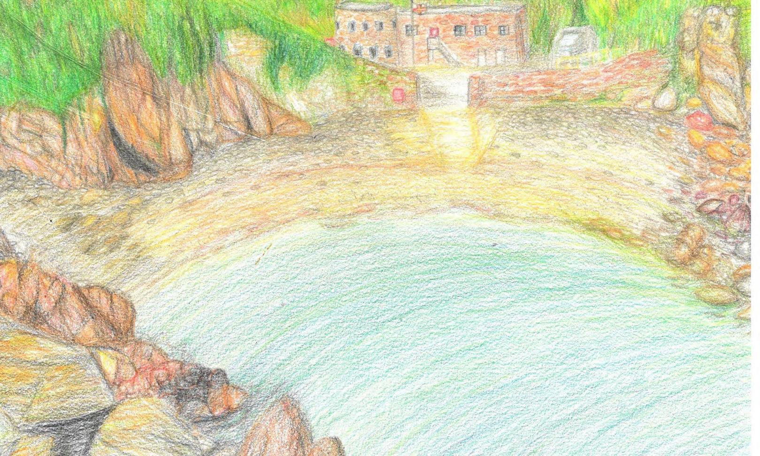

Slide 49


Slide 50
The Island Games Postcard Competition was an opportunity to allow the young people across our Islands to show how they saw their homes through a postcard format. We saw over 120 entries received, and through this have chosen 9 postcards to be printed and will be used to send messages of well wishes.
We hope you enjoy viewing all the entries compiled together from each Island that took part. Thank you to each person who submitted an entry – you have given us a fantastic insight into your Island to share with our fellow Islanders.

Slide 51

JERSEY
Jèrriais teaching service - years 3 to 6 Grainville School - year 8 and 9

Slide 52
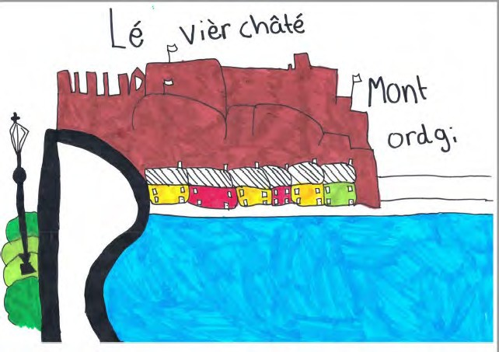

Slide 53
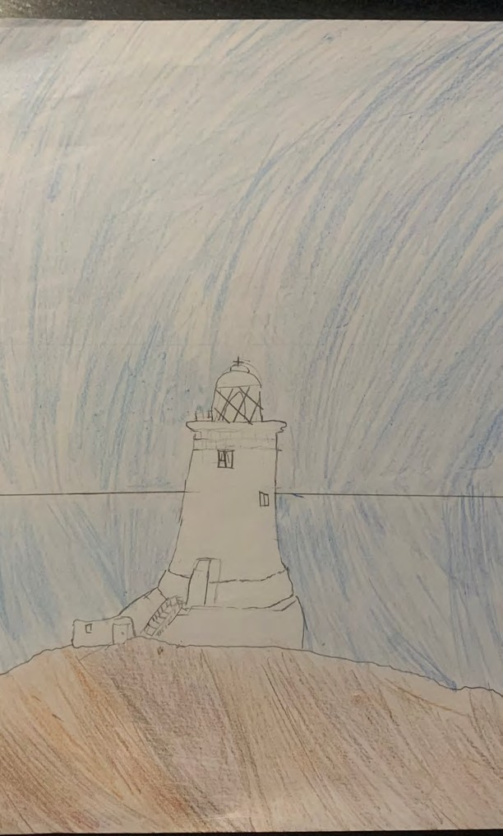

Slide 54
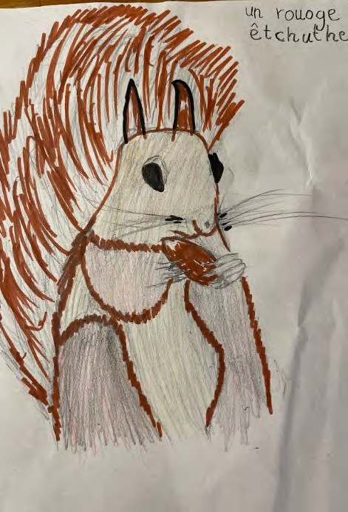

Slide 55
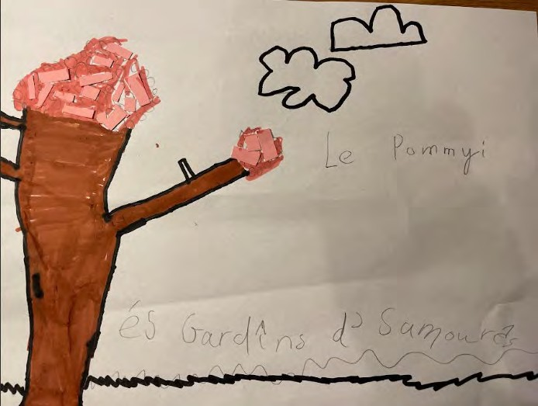

Slide 56
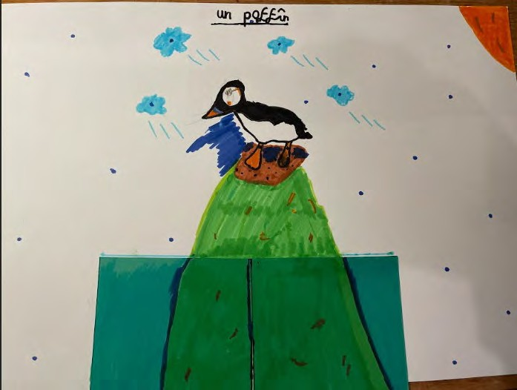

Slide 57
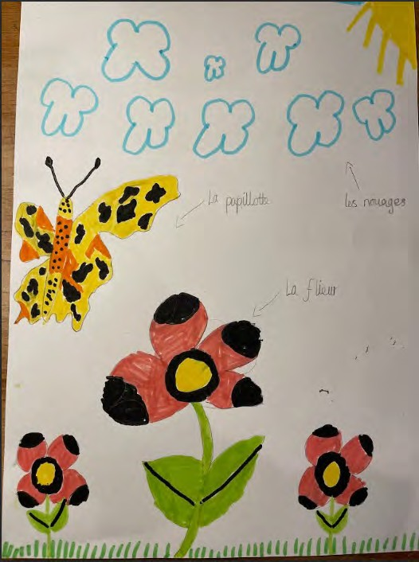
No.36

Slide 58
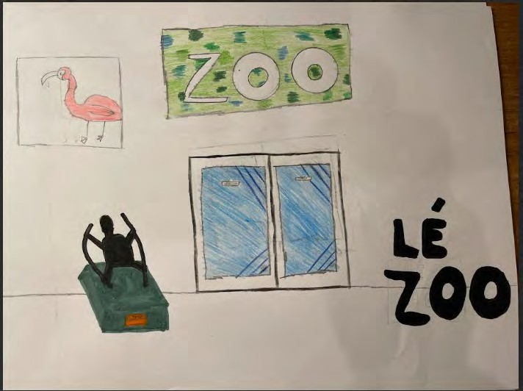
No.37

Slide 59


Slide 60


Slide 61


Slide 62


Slide 63


Slide 64


Slide 65


Slide 66


Slide 67


Slide 68


Slide 69


Slide 70


Slide 71


Slide 72


Slide 73


Slide 74


Slide 75
The Island Games Postcard Competition was an opportunity to allow the young people across our Islands to show how they saw their homes through a postcard format. We saw over 120 entries received, and through this have chosen 9 postcards to be printed and will be used to send messages of well wishes.
We hope you enjoy viewing all the entries compiled together from each Island that took part. Thank you to each person who submitted an entry – you have given us a fantastic insight into your Island to share with our fellow Islanders.

Slide 76

ORKNEY
Rousay Community School – P5,6&7

Slide 77


Slide 78


Slide 79


Slide 80


Slide 81


Slide 82


Slide 83


Slide 84


Slide 85


Slide 86


Slide 87


Slide 88


Slide 89


Slide 90
The Island Games Postcard Competition was an opportunity to allow the young people across our Islands to show how they saw their homes through a postcard format. We saw over 120 entries received, and through this have chosen 9 postcards to be printed and will be used to send messages of well wishes.
We hope you enjoy viewing all the entries compiled together from each Island that took part. Thank you to each person who submitted an entry – you have given us a fantastic insight into your Island to share with our fellow Islanders.

Slide 91

SAAREMAA
Kuressaare Kunstikool – age 9 to 14

Slide 92


Slide 93


Slide 94


Slide 95


Slide 96


Slide 97


Slide 98


Slide 99


Slide 100


Slide 101


Slide 102


Slide 103


Slide 104


Slide 105


Slide 106


Slide 107


Slide 108


Slide 109


Slide 110
The Island Games Postcard Competition was an opportunity to allow the young people across our Islands to show how they saw their homes through a postcard format. We saw over 120 entries received, and through this have chosen 9 postcards to be printed and will be used to send messages of well wishes.
We hope you enjoy viewing all the entries compiled together from each Island that took part. Thank you to each person who submitted an entry – you have given us a fantastic insight into your Island to share with our fellow Islanders.

Slide 111

SARK
Sark School students

Slide 112


Slide 113


Slide 114


Slide 115


Slide 116


Slide 117


Slide 118


Slide 119


Slide 120
The Island Games Postcard Competition was an opportunity to allow the young people across our Islands to show how they saw their homes through a postcard format. We saw over 120 entries received, and through this have chosen 9 postcards to be printed and will be used to send messages of well wishes.
We hope you enjoy viewing all the entries compiled together from each Island that took part. Thank you to each person who submitted an entry – you have given us a fantastic insight into your Island to share with our fellow Islanders.

Slide 121

WESTERN ISLES
Stornoway Primary – year 7 D MacAlpine – age 12

Slide 122


Slide 123


Slide 124


Slide 125


Slide 126


Slide 127


Slide 128


Slide 129


Slide 130


Slide 131


Slide 132


Slide 133


Slide 134


Slide 135


Slide 136


Slide 137


Slide 138


Slide 139


Slide 140


Slide 141


Slide 142


Slide 143


Slide 144


Slide 145


Slide 146


Slide 147


Slide 148


